Slide 1
Session 1: Introduction to Machine Learning in Finance

Slide 2
Analytics
Notes:
What is
Data Science Project Life-cycle?
Data Products?
Data Engineering?
https://www.datasciencecentral.com/profiles/blogs/the-data-science-project-lifecycle
https://www.dezyre.com/article/life-cycle-of-a-data-science-project/270
https://docs.microsoft.com/en-us/azure/machine-learning/team-data-science-process/overview
https://www.dataquest.io/blog/what-is-a-data-engineer/
https://cognitiveclass.ai/blog/data-scientist-vs-data-engineer/
http://www.juiceanalytics.com/writing/turning-data-into-product
https://www.safaribooksonline.com/library/view/data-analytics-with/9781491913734/ch01.html
https://sloanreview.mit.edu/article/designing-and-developing-analytics-based-data-products/
[Carsten Bange] http://www.digitalistmag.com/cio-knowledge/2016/11/07/building-data-products-realize-data-driven-business-models-04635900
Data Project Lifecycle
1.1 Understand the different stages of data project life cycle 1.2 Explore data from different sources 1.3 Discuss the impact of implementing data in an organisation 1.4 Understand the types of data products
Data Management
Data Engineering

Slide 3
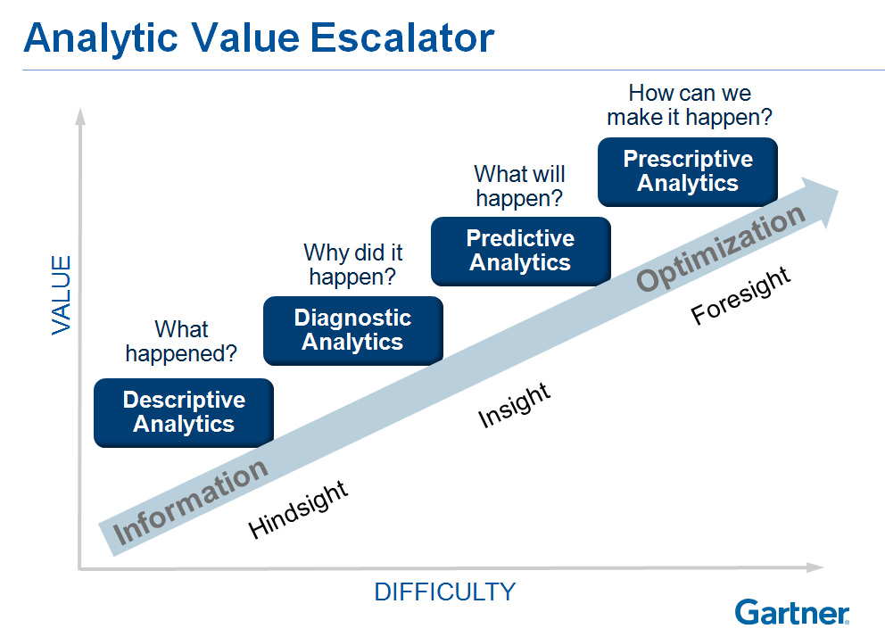
Types of Analytics
Notes:
https://www.flickr.com/photos/27772229@N07/8267855748

Slide 4
Types of Analytics
Descriptive Analytics
Make use of data aggregation and data mining to provide insight into the past and answer: “What has happened?”
Predictive Analytics
Make use of statistical models and forecasts techniques to understand the future and answer: “What could happen?”
Prescriptive Analytics
Make use of optimisation and simulation algorithms to advice on possible outcomes and answer: “What should we do?”
Notes:
https://dzone.com/articles/data-science-vs-data-analysis-whats-the-difference
https://hbr.org/2012/10/data-scientist-the-sexiest-job-of-the-21st-century
http://www.growwithfarm.com/evolving-analytics-from-descriptive-to-prescriptive/
https://halobi.com/blog/descriptive-predictive-and-prescriptive-analytics-explained/
http://www.informationweek.com/big-data/big-data-analytics/big-data-analytics-descriptive-vs-predictive-vs-prescriptive/d/d-id/1113279
"Prescriptive analytics is a type of predictive analytics," Wu said. "It's basically when we need to prescribe an action, so the business decision-maker can take this information and act.“ ~ Dr. Michael Wu

Slide 5
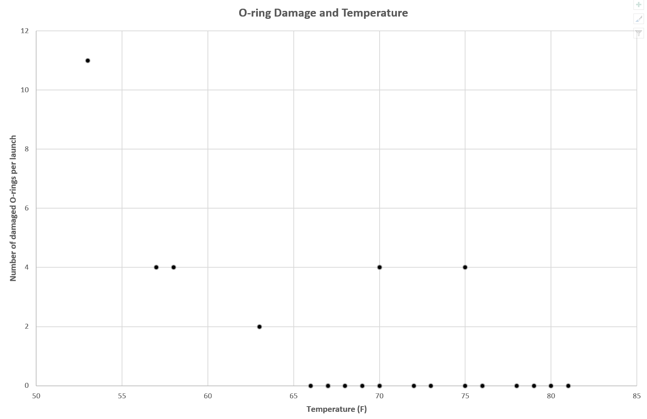
Diagnostic Analysis

Slide 6
Data Analysis
Notes:
What is
Data Science Project Life-cycle?
Data Products?
Data Engineering?
https://www.datasciencecentral.com/profiles/blogs/the-data-science-project-lifecycle
https://www.dezyre.com/article/life-cycle-of-a-data-science-project/270
https://docs.microsoft.com/en-us/azure/machine-learning/team-data-science-process/overview
https://www.dataquest.io/blog/what-is-a-data-engineer/
https://cognitiveclass.ai/blog/data-scientist-vs-data-engineer/
http://www.juiceanalytics.com/writing/turning-data-into-product
https://www.safaribooksonline.com/library/view/data-analytics-with/9781491913734/ch01.html
https://sloanreview.mit.edu/article/designing-and-developing-analytics-based-data-products/
[Carsten Bange] http://www.digitalistmag.com/cio-knowledge/2016/11/07/building-data-products-realize-data-driven-business-models-04635900
Data Project Lifecycle
1.1 Understand the different stages of data project life cycle 1.2 Explore data from different sources 1.3 Discuss the impact of implementing data in an organisation 1.4 Understand the types of data products
Data Management
Data Engineering

Slide 7
What is Data Analysis?
Sometimes called Data Analytics
A process of inspecting, cleansing, transforming, and modelling data with the goal of discovering useful information, suggesting conclusions, and supporting decision-making ~ Wikipedia
Data mining is a particular data analysis technique that focuses on modelling and knowledge discovery for predictive rather than purely descriptive purposes
Business intelligence covers data analysis that relies heavily on aggregation, focusing on business information.
Notes:
https://dzone.com/articles/data-science-vs-data-analysis-whats-the-difference
https://hbr.org/2012/10/data-scientist-the-sexiest-job-of-the-21st-century

Slide 8
What is Data Analysis?
In statistical applications data analysis can be divided into
Descriptive statistics,
Exploratory data analysis (EDA),
Confirmatory data analysis (CDA).
EDA focuses on discovering new features in the data
CDA on confirming or falsifying existing hypotheses.
Predictive analytics focuses on application of statistical models for predictive forecasting or classification
Text analytics applies statistical, linguistic, and structural techniques to extract and classify information from textual sources, a species of unstructured data.
Notes:
https://en.wikipedia.org/wiki/Data_analysis
https://www.quora.com/What-is-the-main-purpose-of-data-analysis
https://dzone.com/articles/data-science-vs-data-analysis-whats-the-difference
https://hbr.org/2012/10/data-scientist-the-sexiest-job-of-the-21st-century

Slide 9
What is Data Analysis?
A/B Testing
Association Rule Learning
Classification
Cluster Analysis
Data mining
Ensemble learning
Genetic algorithms
Machine learning
Natural language processing (NLP)
Neural networks
Network analysis
Optimisation
Pattern recognition
Predictive modelling
Regression
Sentiment analysis
Signal processing
Spatial analysis
Supervised learning
Simulation
Time series analysis
Time series forecasting
Unsupervised learning
Visualisation

Slide 10
Data Science
Notes:
What is
Data Science Project Life-cycle?
Data Products?
Data Engineering?
https://www.datasciencecentral.com/profiles/blogs/the-data-science-project-lifecycle
https://www.dezyre.com/article/life-cycle-of-a-data-science-project/270
https://docs.microsoft.com/en-us/azure/machine-learning/team-data-science-process/overview
https://www.dataquest.io/blog/what-is-a-data-engineer/
https://cognitiveclass.ai/blog/data-scientist-vs-data-engineer/
http://www.juiceanalytics.com/writing/turning-data-into-product
https://www.safaribooksonline.com/library/view/data-analytics-with/9781491913734/ch01.html
https://sloanreview.mit.edu/article/designing-and-developing-analytics-based-data-products/
[Carsten Bange] http://www.digitalistmag.com/cio-knowledge/2016/11/07/building-data-products-realize-data-driven-business-models-04635900
Data Project Lifecycle
1.1 Understand the different stages of data project life cycle 1.2 Explore data from different sources 1.3 Discuss the impact of implementing data in an organisation 1.4 Understand the types of data products
Data Management
Data Engineering

Slide 11
What is Data Science?
Includes data analysis
Goes much beyond
Data Scientist end goal? Insight discovery
Data Scientist
Interests is aligned with company goals
Proposed the hypothesis or questions
Data Analyst goes about answering those questions
Notes:
https://www.safaribooksonline.com/library/view/what-is-data/9781449336080/ch01.html#what_is_data_sciencequestion_mar-id00001
https://dzone.com/articles/data-science-vs-data-analysis-whats-the-difference
https://hbr.org/2012/10/data-scientist-the-sexiest-job-of-the-21st-century
http://www.dataists.com/2010/09/a-taxonomy-of-data-science/
https://hophr.com/blog

Slide 12

Source: Drew Conway
Notes:
http://drewconway.com/zia/2013/3/26/the-data-science-venn-diagram

Slide 13
Some Terminologies
Analytics
Analytics is the discovery, interpretation, and communication of meaningful patterns in data. Especially valuable in areas rich with recorded information, analytics relies on the simultaneous application of statistics, computer programming and operations research to quantify performance.
Multidisciplinary.
Extensive use of data analysis.
Insights used to recommend action or to guide business decision making.
Individual analyses forms part of it
Concerned with the entire methodology.
Analysis
Extensive use of mathematics and statistics
Make use of descriptive techniques and predictive models
Notes:
https://hbr.org/2013/12/analytics-30?referral=03759&cm_vc=rr_item_page.bottom
https://en.wikipedia.org/wiki/Business_analytics
Business analytics (BA) refers to the skills, technologies, practices for continuous iterative exploration and investigation of past business performance to gain insight and drive business planning. Business analytics focuses on developing new insights and understanding of business performance based on data and statistical methods. In contrast, business intelligence traditionally focuses on using a consistent set of metrics to both measure past performance and guide business planning, which is also based on data and statistical methods.
Business analytics makes extensive use of statistical analysis, including explanatory and predictive modeling,[2] and fact-based management to drive decision making. It is therefore closely related to management science. Analytics may be used as input for human decisions or may drive fully automated decisions. Business intelligence is querying, reporting, online analytical processing (OLAP), and “alerts.”
https://whitman.syr.edu/programs-and-academics/programs/ms/Business-Analytics/index.aspx
Curriculum
The STEM designated full-time MS Business Analytics program is a 36-credit hour program. Through hands-on coursework students hone their decision-making skills and learn to use analytic tools to drive positive outcomes for businesses.
Curriculum Outline:
Required Courses Analytics Core (6 credits – Both courses required)
• Data Analysis & Decision Making
• Business Analytics
Analytics Applications Core (6 credits - select 2)
• Accounting Analytics
• Marketing Analytics
• Financial Analytics
• Principles of Management Science
Analytics Depth Core (6 credits - select 2 – can include any not already selected from Analytics Applications Core)
• Linear Statistical Models
• Time Series Modeling and Analysis
• Customer Relationship Management with SAP
• Applied Data Science
• Advanced Data Analytics
• Statistical Methods in Information Science and Technology
• Data Mining
• Basics of Information Retrieval Systems
• Information Visualization
• Data Warehouse
• Research Methods in Information Science and Technology
• Introduction to Database Management Systems
• Analytical Data Mining
Analytics Electives (18 credits - 6 select courses – can include any not selected from Analytics Applications Core or Analytics Depth Core)
• Data Base Administration Concepts & DB Mgt
• Natural Language Processing
• Object-oriented programming in C++
• Introduction to Artificial Intelligence
• Explorations in Computing & Programming
• Artificial Neural Networks
• Software Engineering
• Simulation and Modeling
http://www.comp.nus.edu.sg/programmes/ug/ba/
http://msba.nus.edu/

Slide 14
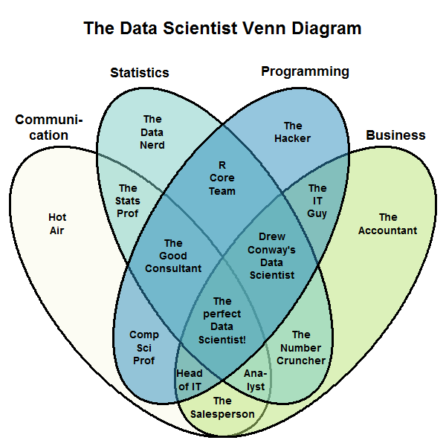
Source: Stephan Kolassa
Notes:
http://drewconway.com/zia/2013/3/26/the-data-science-venn-diagram
https://datascience.stackexchange.com/questions/2403/data-science-without-knowledge-of-a-specific-topic-is-it-worth-pursuing-as-a-ca

Slide 15
What is Data Science?
Data science, also known as data-driven science, is an interdisciplinary field of scientific methods, processes, algorithms and systems to extract knowledge or insights from data in various forms, either structured or unstructured, similar to data mining.
Data science is a "concept to unify statistics, data analysis, machine learning and their related methods" in order to "understand and analyse actual phenomena" with data.
Source: Wikipedia
Notes:
https://dzone.com/articles/data-science-vs-data-analysis-whats-the-difference
https://hbr.org/2012/10/data-scientist-the-sexiest-job-of-the-21st-century

Slide 16
https://www.oreilly.com/ideas/what-is-data-science
https://www.oreilly.com/ideas/how-intelligent-data-platforms-are-powering-smart-cities
https://www.oreilly.com/learning/introducing-pandas-objects
Notes:
https://www.oreilly.com/ideas/what-is-data-science

Slide 17
Activity - HBR Article
Data Scientist: The Sexiest Job of the 21st Century
Read the article and answer the following questions
How did Goldman approach his work?
Was he welcomed? How did he overcome the obstacles?
What are the traits of a Data Scientist?
The first step in filling the need for data scientists, therefore, is to understand what they do in businesses. Then ask, What skills do they need? And what fields are those skills most readily found in?
What is the aspiration of a data scientist?
What do data scientist do?
Notes:
https://dzone.com/articles/data-science-vs-data-analysis-whats-the-difference
https://hbr.org/2012/10/data-scientist-the-sexiest-job-of-the-21st-century
http://dataconomy.com/2014/10/how-to-become-a-data-scientist-in-12-weeks-with-metis/
http://www.thisismetis.com/data-science-bootcamps
1. How did Goldman approach his work?
Goldman, a PhD in physics from Stanford, was intrigued by the linking he did see going on and by the richness of the user profiles. It all made for messy data and unwieldy analysis, but as he began exploring people’s connections, he started to see possibilities. He began forming theories, testing hunches, and finding patterns that allowed him to predict whose networks a given profile would land in. He could imagine that new features capitalizing on the heuristics he was developing might provide value to users.
Answer: Observe. Theorise. Conduct test. Discover patterns. Predict.
2. Was he welcomed? How did he overcome the obstacles?
There was a champion in the organisation in the person of Reid Hoffman, LinkedIn’s cofounder and CEO.
3.
Goldman is a good example of a new key player in organizations: the “data scientist.” It’s a high-ranking professional with the training and curiosity to make discoveries in the world of big data. The title has been around for only a few years. (It was coined in 2008 by one of us, D.J. Patil, and Jeff Hammerbacher, then the respective leads of data and analytics efforts at LinkedIn and Facebook.) But thousands of data scientists are already working at both start-ups and well-established companies. Their sudden appearance on the business scene reflects the fact that companies are now wrestling with information that comes in varieties and volumes never encountered before. If your organization stores multiple petabytes of data, if the information most critical to your business resides in forms other than rows and columns of numbers, or if answering your biggest question would involve a “mashup” of several analytical efforts, you’ve got a big data opportunity.
What kind of person does all this? What abilities make a data scientist successful? Think of him or her as a hybrid of data hacker, analyst, communicator, and trusted adviser.
Data scientists’ most basic, universal skill is the ability to write code. This may be less true in five years’ time, when many more people will have the title “data scientist” on their business cards. More enduring will be the need for data scientists to communicate in language that all their stakeholders understand—and to demonstrate the special skills involved in storytelling with data, whether verbally, visually, or—ideally—both.
an intense curiosity
4. The first step in filling the need for data scientists, therefore, is to understand what they do in businesses. Then ask, What skills do they need? And what fields are those skills most readily found in?
Roumeliotis was clear with us that he doesn’t hire on the basis of statistical or analytical capabilities. He begins his search for data scientists by asking candidates if they can develop prototypes in a mainstream programming language such as Java. Roumeliotis seeks both a skill set—a solid foundation in math, statistics, probability, and computer science—and certain habits of mind. He wants people with a feel for business issues and empathy for customers. Then, he says, he builds on all that with on-the-job training and an occasional course in a particular technology.
How to Find the Data Scientists You Need
1. Focus recruiting at the “usual suspect” universities (Stanford, MIT, Berkeley, Harvard, Carnegie Mellon) and also at a few others with proven strengths: North Carolina State, UC Santa Cruz, the University of Maryland, the University of Washington, and UT Austin.
2. Scan the membership rolls of user groups devoted to data science tools. The R User Groups (for an open-source statistical tool favored by data scientists) and Python Interest Groups (for PIGgies) are good places to start.
3. Search for data scientists on LinkedIn—they’re almost all on there, and you can see if they have the skills you want.
4. Hang out with data scientists at the Strata, Structure:Data, and Hadoop World conferences and similar gatherings (there is almost one a week now) or at informal data scientist “meet-ups” in the Bay Area; Boston; New York; Washington, DC; London; Singapore; and Sydney.
5. Make friends with a local venture capitalist, who is likely to have gotten a variety of big data proposals over the past year.
6. Host a competition on Kaggle or TopCoder, the analytics and coding competition sites. Follow up with the most-creative entrants.
7. Don’t bother with any candidate who can’t code. Coding skills don’t have to be at a world-class level but should be good enough to get by. Look for evidence, too, that candidates learn rapidly about new technologies and methods.
8. Make sure a candidate can find a story in a data set and provide a coherent narrative about a key data insight. Test whether he or she can communicate with numbers, visually and verbally.
9. Be wary of candidates who are too detached from the business world. When you ask how their work might apply to your management challenges, are they stuck for answers?
10. Ask candidates about their favorite analysis or insight and how they are keeping their skills sharp. Have they gotten a certificate in the advanced track of Stanford’s online Machine Learning course, contributed to open-source projects, or built an online repository of code to share (for example, on GitHub)?
5. What is the aspiration of a data scientist?
But our informal survey of the priorities of data scientists revealed something more fundamentally important. They want to be “on the bridge.” The reference is to the 1960s television show Star Trek, in which the starship captain James Kirk relies heavily on data supplied by Mr. Spock. Data scientists want to be in the thick of a developing situation, with real-time awareness of the evolving set of choices it presents.
6.
More than anything, what data scientists do is make discoveries while swimming in data. It’s their preferred method of navigating the world around them. At ease in the digital realm, they are able to bring structure to large quantities of formless data and make analysis possible. They identify rich data sources, join them with other, potentially incomplete data sources, and clean the resulting set. In a competitive landscape where challenges keep changing and data never stop flowing, data scientists help decision makers shift from ad hoc analysis to an ongoing conversation with data.
[*]. Develop their own tools
Given the nascent state of their trade, it often falls to data scientists to fashion their own tools and even conduct academic-style research. Yahoo, one of the firms that employed a group of data scientists early on, was instrumental in developing Hadoop. Facebook’s data team created the language Hive for programming Hadoop projects. Many other data scientists, especially at data-driven companies such as Google, Amazon, Microsoft, Walmart, eBay, LinkedIn, and Twitter, have added to and refined the tool kit.

Slide 18
Some Terminologies
Business Analytics
Refers to the skills, technologies, practices for continuous iterative exploration and investigation of past business performance to gain insight and drive business planning.
Focuses on developing new insights and understanding of business performance based on data and statistical methods.
Business Intelligence
Traditionally focuses on using a consistent set of metrics to both measure past performance and guide business planning, which is also based on data and statistical methods.
Business Analysis
Business analysis is a research discipline of identifying business needs and determining solutions to business problems. Solutions often include a software-systems development component, but may also consist of process improvement, organizational change or strategic planning and policy development.
Notes:
https://en.wikipedia.org/wiki/Business_analytics
Business analytics (BA) refers to the skills, technologies, practices for continuous iterative exploration and investigation of past business performance to gain insight and drive business planning. Business analytics focuses on developing new insights and understanding of business performance based on data and statistical methods. In contrast, business intelligence traditionally focuses on using a consistent set of metrics to both measure past performance and guide business planning, which is also based on data and statistical methods.
Business analytics makes extensive use of statistical analysis, including explanatory and predictive modeling,[2] and fact-based management to drive decision making. It is therefore closely related to management science. Analytics may be used as input for human decisions or may drive fully automated decisions. Business intelligence is querying, reporting, online analytical processing (OLAP), and “alerts.”
https://whitman.syr.edu/programs-and-academics/programs/ms/Business-Analytics/index.aspx
Curriculum
The STEM designated full-time MS Business Analytics program is a 36-credit hour program. Through hands-on coursework students hone their decision-making skills and learn to use analytic tools to drive positive outcomes for businesses.
Curriculum Outline:
Required Courses Analytics Core (6 credits – Both courses required)
• Data Analysis & Decision Making
• Business Analytics
Analytics Applications Core (6 credits - select 2)
• Accounting Analytics
• Marketing Analytics
• Financial Analytics
• Principles of Management Science
Analytics Depth Core (6 credits - select 2 – can include any not already selected from Analytics Applications Core)
• Linear Statistical Models
• Time Series Modeling and Analysis
• Customer Relationship Management with SAP
• Applied Data Science
• Advanced Data Analytics
• Statistical Methods in Information Science and Technology
• Data Mining
• Basics of Information Retrieval Systems
• Information Visualization
• Data Warehouse
• Research Methods in Information Science and Technology
• Introduction to Database Management Systems
• Analytical Data Mining
Analytics Electives (18 credits - 6 select courses – can include any not selected from Analytics Applications Core or Analytics Depth Core)
• Data Base Administration Concepts & DB Mgt
• Natural Language Processing
• Object-oriented programming in C++
• Introduction to Artificial Intelligence
• Explorations in Computing & Programming
• Artificial Neural Networks
• Software Engineering
• Simulation and Modeling
http://www.comp.nus.edu.sg/programmes/ug/ba/
http://msba.nus.edu/

Slide 19
Machine Learning
[Machine Learning is the] field of study that gives computers the ability to learn without being explicitly programmed.
Arthur Samuel, 1959

Slide 20
Why Machine Learning?
Set rules versus ML
E.g., Spam filtering
ML is great for:
Problems the requires a lot of hand-tuning or long list of rules
Complex problems
Evolving environment: Adapts to new data
Pattern discovery / Provides insights
Good Resource: McKinsey’s An executive’s guide to AI

Slide 21
Types of Machine Learning Algorithms – When to use it?
Supervised
You know how to classify the input data and the type of behaviour you want to predict, but you need the algorithm to calculate it for you on new data
Unsupervised
You do not know how to classify the data, and you want the algorithm to find patterns and classify the data for you
Reinforcement Learning
You don’t have a lot of training data; you cannot clearly define the ideal end state; or the only way to learn about the environment is to interact with it
Source: McKinsey’s An executive’s guide to AI

Slide 22
Types of Machine Learning Algorithms
Supervised
Regression
Linear Regression, Penalised Methods, Tree based
Classification
Logistic Regression, Tree based, Bagging, Boosting
Unsupervised
Clustering
Visualisation / Dimensionality Reduction
Association rule learning
Semi-supervised
Reinforcement Learning
Good Resource: McKinsey’s An executive’s guide to AI

Slide 23
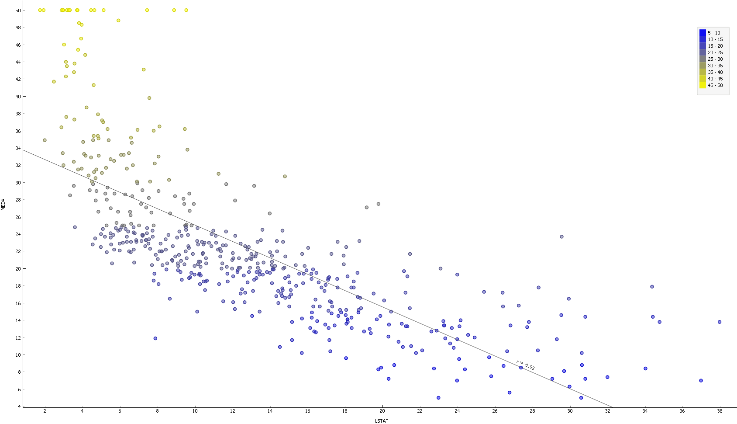
Regression

Slide 24
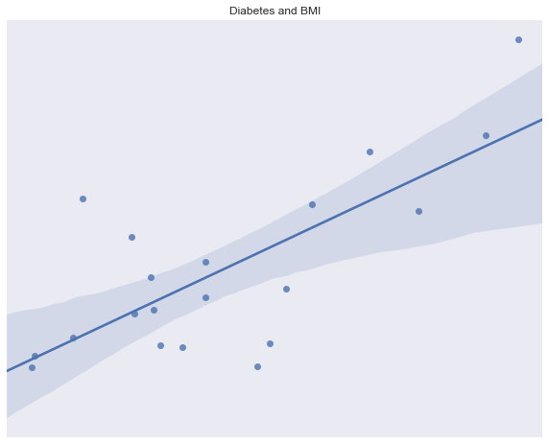
Regression

Slide 25

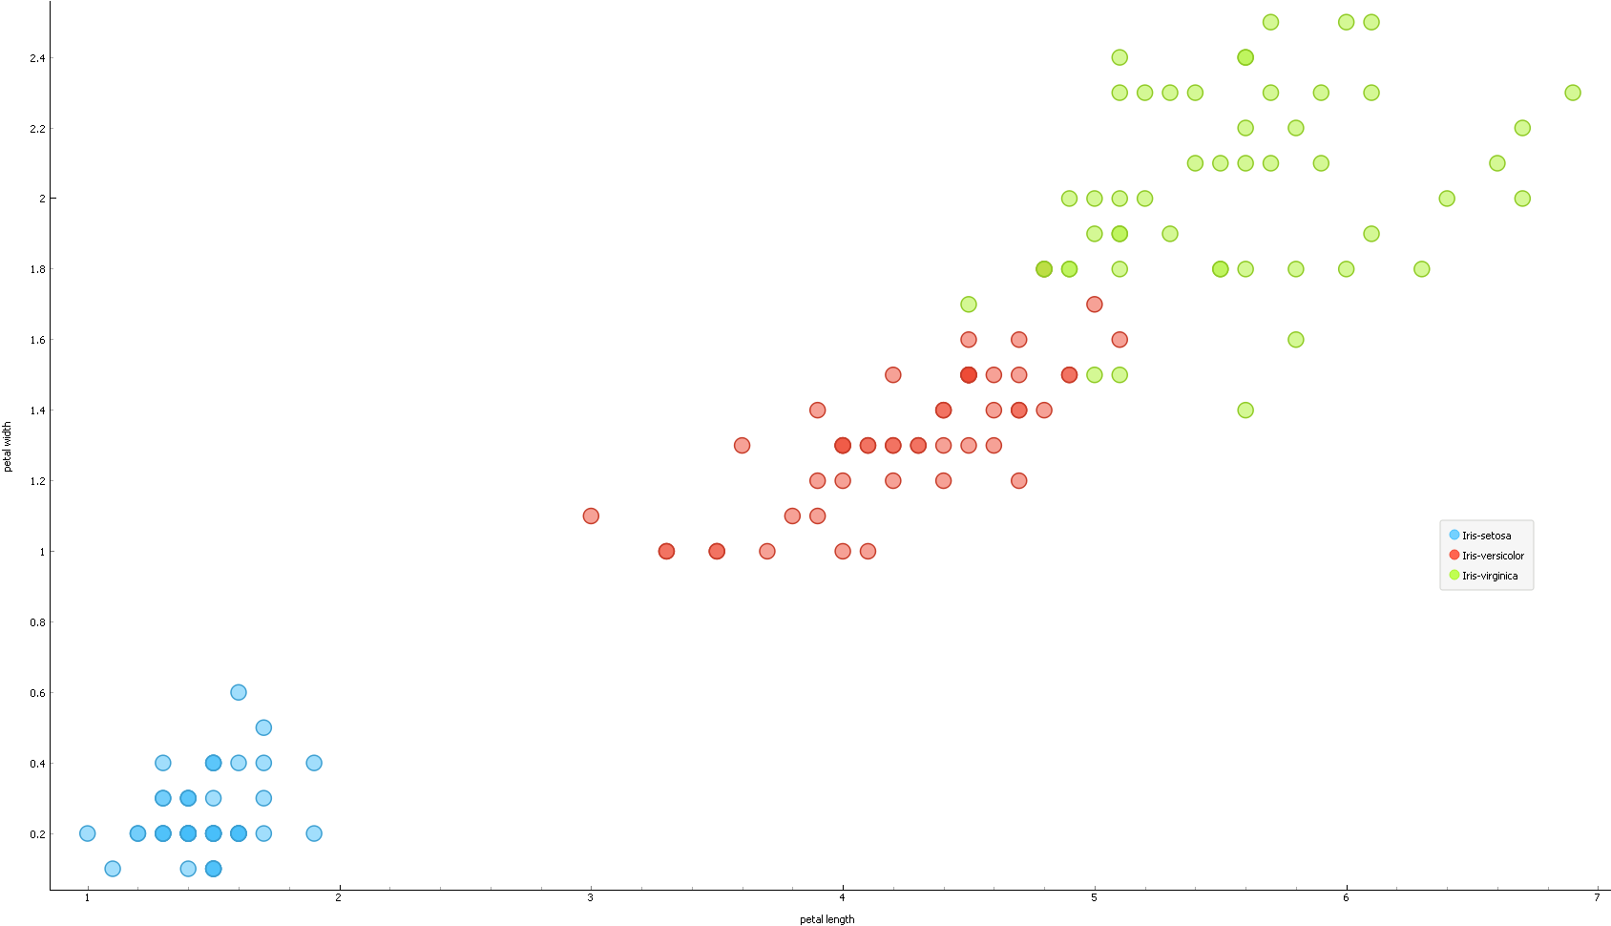
Classification

Slide 26

Deep Learning - Convolutional NN
Source: https://samirashabanian.wordpress.com/2015/02/15/convolutional-neural-network/

Slide 27
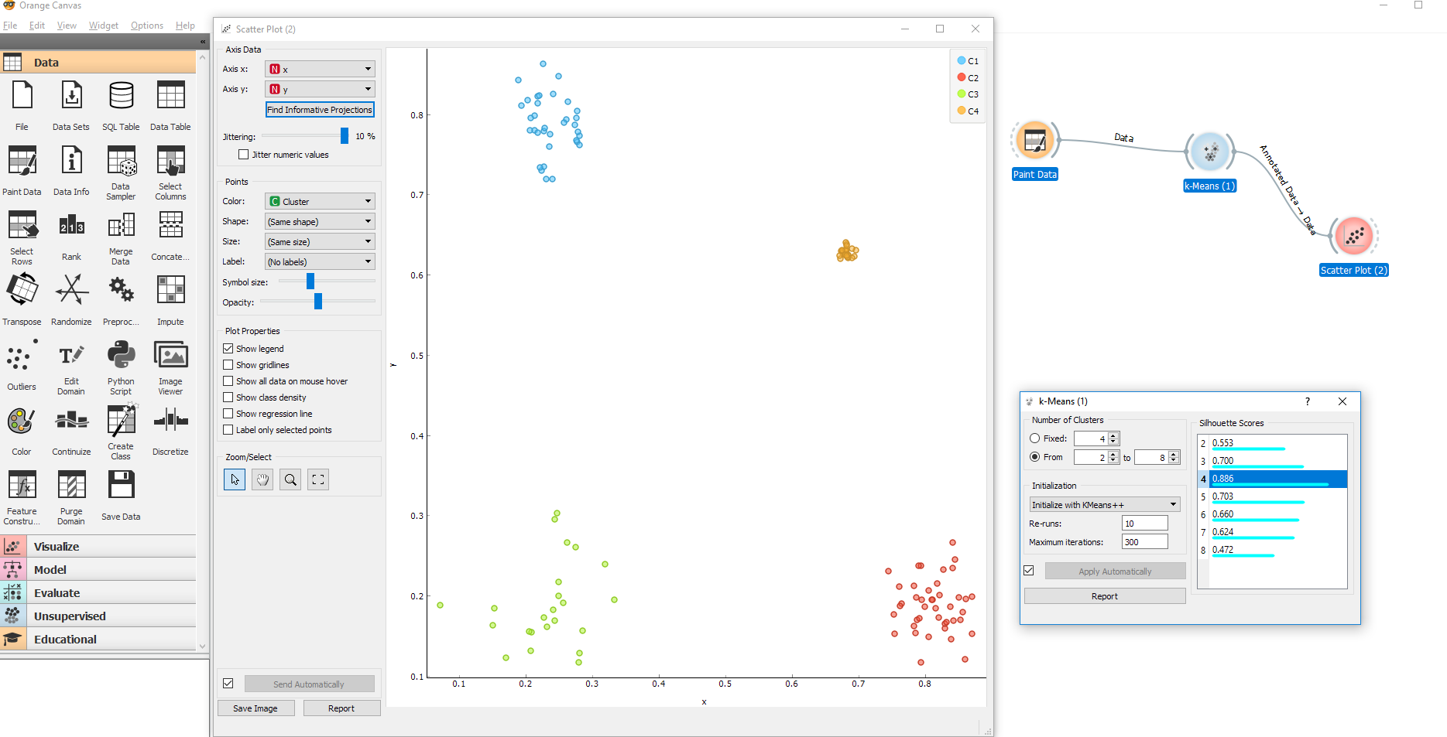
Unsupervised

Slide 28

Reinforcement Learning - 2015

Slide 29

Reinforcement Learning - 2017

Slide 30
Unsupervised

Slide 31
Supervised learning
Red, blue, white, green > Label for comp to learn
Feature - colour
Unsupervised learning
Colours
How does comp tell?
Based on similar features

Slide 32
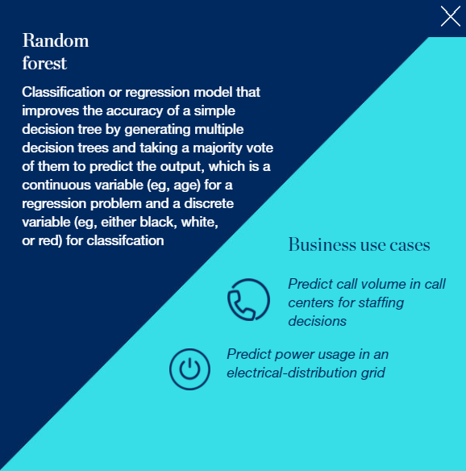
Supervised Learning – Use Case
Source: McKinsey’s An executive’s guide to AI

Slide 33
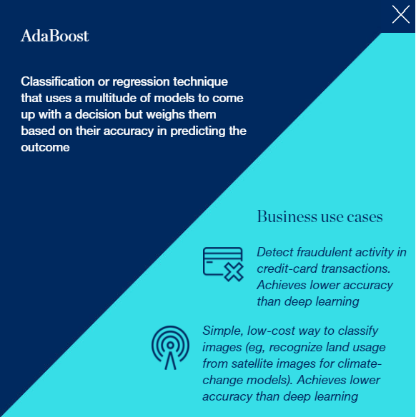
Supervised Learning – Use Case
Source: McKinsey’s An executive’s guide to AI

Slide 34
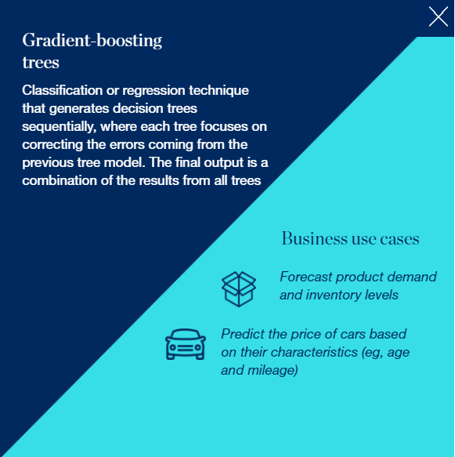
Supervised Learning – Use Case
Source: McKinsey’s An executive’s guide to AI

Slide 35
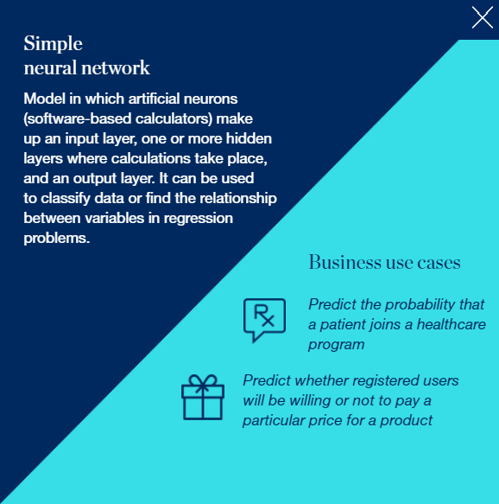
Supervised Learning – Use Case
Source: McKinsey’s An executive’s guide to AI

Slide 36
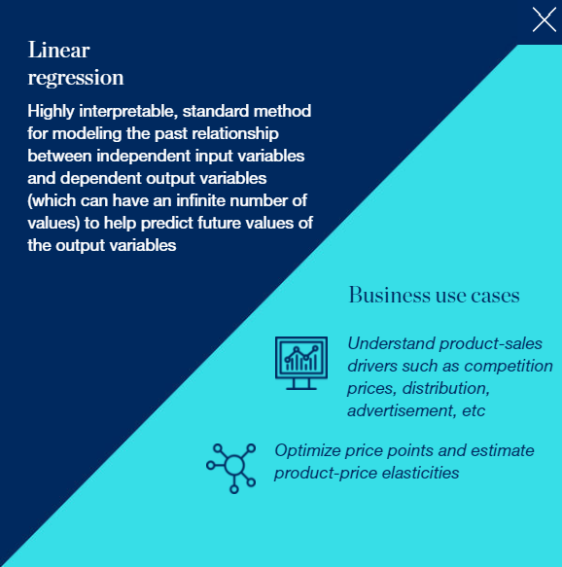
Supervised Learning – Use Case
Source: McKinsey’s An executive’s guide to AI

Slide 37
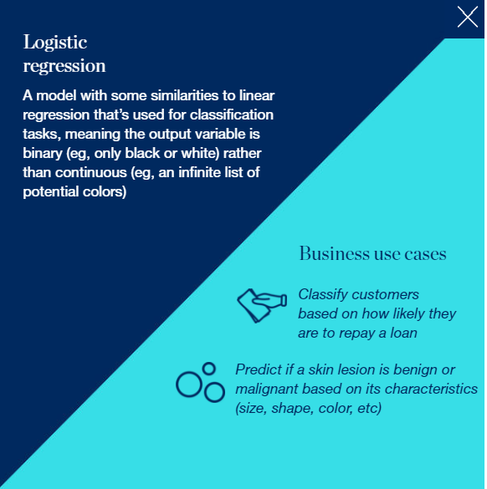
Supervised Learning – Use Case
Source: McKinsey’s An executive’s guide to AI

Slide 38
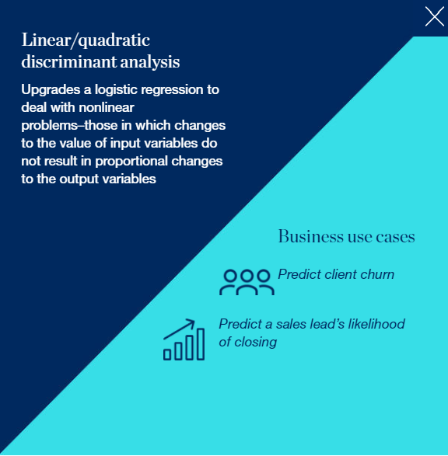
Supervised Learning – Use Case
Source: McKinsey’s An executive’s guide to AI

Slide 39
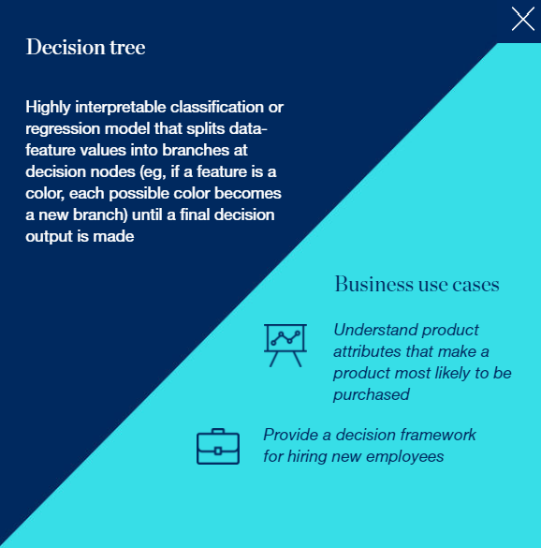
Supervised Learning – Use Case
Source: McKinsey’s An executive’s guide to AI

Slide 40
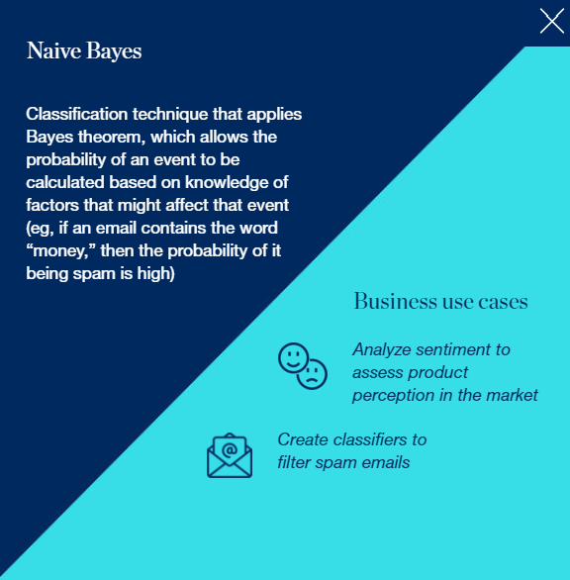
Supervised Learning – Use Case
Source: McKinsey’s An executive’s guide to AI

Slide 41
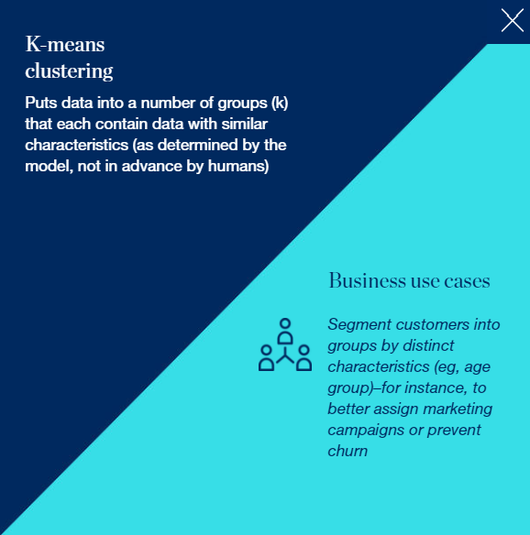
Unsupervised Learning – Use Case
Source: McKinsey’s An executive’s guide to AI

Slide 42
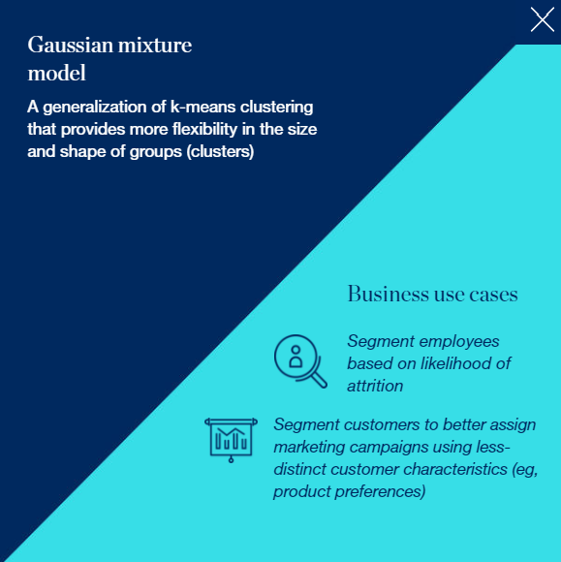
Unsupervised Learning – Use Case
Source: McKinsey’s An executive’s guide to AI

Slide 43
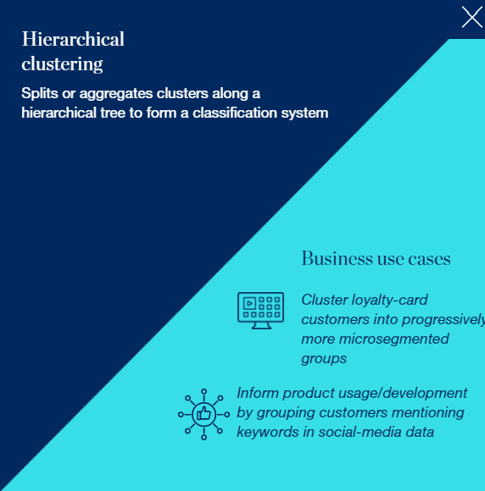
Unsupervised Learning – Use Case
Source: McKinsey’s An executive’s guide to AI

Slide 44
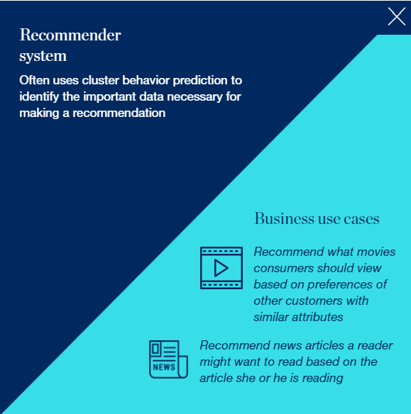
Unsupervised Learning – Use Case
Source: McKinsey’s An executive’s guide to AI

Slide 45





Reinforcement Learning – Use Case
Optimise the trading strategy for an options-trading portfolio
Balance the load of electricity grids in varying demand cycles
Stock and pick inventory using robots
Optimise the driving behaviour of self-driving cars
Optimise pricing in real time for an online auction of a product with limited supply
Source: McKinsey’s An executive’s guide to AI

Slide 46
Deep Learning General Use Case
Sound | Industry
Voice recognition | UX/UI, Automotive, Security, loT
Voice search | Handset maker, Telecoms
Sentiment analysis | CRM
Flaw detection (engine noise) | Automotive, Aviation
Fraud detection (latent audio artefacts) | Finance, Credit Cards
Time Series | Industry
Log analysis/Risk detection | Data centres, Security, Finance
Enterprise resource planning | Manufacturing, Auto., Supply chain
Predictive analysis using sensor data | loT, Smart home, Hardware manufacturing
Business and Economic analytics | Finance, Accounting, Government
Recommendation engine | E-commerce, Media, Social Networks
Source: https://deeplearning4j.org/use_cases

Slide 47
Deep Learning General Use Case
Text | Industry
Sentiment Analysis | CRM, Social media, Reputation mgt.
Augmented search, Theme detection | Finance
Threat detection | Social media, Govt.
Fraud detection | Insurance, Finance
Image | Industry
Facial recognition, Image search | Social media
Machine vision | Automotive, aviation
Photo clustering | Telecom, Handset makers
Video | Industry
Motion detection | Gaming, UX, UI
Real-time threat detection | Security, Airports
Source: https://deeplearning4j.org/use_cases

Slide 48
Driver of AI
Big Data
Cheap Computational Power
Cheap Storage
Advances in Machine Learning and Deep Learning

Slide 49
Machine Learning Algorithms

Slide 50

Source: Nvidia https://bit.ly/2aoQwIx

Slide 51

Source: http://scikit-learn.org/stable/tutorial/machine_learning_map/index.html

Slide 53
Machine Learning in Finance
Supervised Machine Learning

Slide 54
Credit Scoring

Slide 55
Credit Scoring
Statistical forecast of individual credit risk
To objectively evaluate creditworthiness of borrowers
Ability
Willingness
Used by lenders in
Loan approval
Evaluating risk based charge (E.g., interest rate benchmark + margin)
Source: WPS Analytics
Notes:
https://www.worldprogramming.com/blog/credit_scoring_development_pt1
https://www.quora.com/What-is-the-purpose-of-a-credit-score

Slide 56
Credit Scoring - Prehistoric
Performed by loan manager
5Cs
Character
Capital – deposit and loan quantum
Collateral – Security being offered
Capacity – Repaying ability
Condition – Macroeconomic consideration
Source: Credit Scoring Using Machine Learning, https://arrow.dit.ie/sciendoc/137/
Notes:
Credit Scoring Using Machine Learning. Kenneth Kennedy. Dublin Institute of Technology

Slide 57
Credit Scoring - Prehistoric
Shortcomings:
Subject to human emotion
Decisions lacked consistency / difficult to replicate
No set process & difficult to formalise
Not scalable
Source: Credit Scoring Using Machine Learning, https://arrow.dit.ie/sciendoc/137/
Notes:
Credit Scoring Using Machine Learning. Kenneth Kennedy. Dublin Institute of Technology

Slide 58
Credit Scoring
Regulations drove the need for a more objective and transparent process
Equal Credit Opportunity Act (ECOA) 1974
Prohibits a creditor from discriminating against an applicant on the basis of race, colour, religion, national origin, and sex.
Statistically credit scoring systems were proposed
The US Federal Reserve’s Regulation B1 (Section 202.2) required that credit scoring systems must be, amongst other things:
based on data that are derived from an empirical comparison of sample groups or the population of creditworthy and noncreditworthy applicants who applied for credit within a reasonable preceding period of time
Developed and validated using accepted statistical principles and methodology
Source: Credit Scoring Using Machine Learning, https://arrow.dit.ie/sciendoc/137/
Notes:
Credit Scoring Using Machine Learning. Kenneth Kennedy. Dublin Institute of Technology

Slide 59
Credit Scoring
Empirically derived and other credit scoring systems
A credit scoring system is a system that evaluates an applicant’s creditworthiness
Mechanically
Based on key attributes of the applicant
Aspects of the transaction
Information about the applicant
To qualify as an empirically derived, demonstrably and statistically sound, credit scoring system, the system must be:
Based on data that are derived from an empirical comparison of sample groups or the population of creditworthy and non-creditworthy applicants who applied for credit within a reasonable preceding period of time
Developed for the purpose of evaluating the creditworthiness of applicants
Developed and validated using accepted statistical principles and methodology
Periodically revalidated to maintain predictive ability.
Source: Credit Scoring Using Machine Learning, https://arrow.dit.ie/sciendoc/137/
Notes:
Credit Scoring Using Machine Learning. Kenneth Kennedy. Dublin Institute of Technology

Slide 60
Credit Scoring
The risk of default - measuring the risk of a customer defaulting on a particular product (product default scoring) or for any product (customer default scoring) (Hand & Henley, 1997);
Fraud detection - techniques that can detect fraud as soon as possible (Phua et al., 2010);
Response to advertisement campaigns - will the customer respond to a direct mailing of a new product? (Lee & Cho, 2007);
Customer retention - will the customer keep using the product after the expiry of the initial trial period? (Zhao et al., 2005);
Attrition - will the customer change to another lender? (Thomas, 2001);
Product usage - will the customer use a certain product, and if so, to what intensity? (Haenlein et al., 2007); and
Proﬁt scoring - techniques to measure the proﬁtability of a customer on a single product (product proﬁt scoring), and over all products (customer proﬁt scoring). Product default scoring is regarded as the original application of credit scoring (Thomas, 2009a).
Credit scoring, as previously mentioned in Section 1.2, remains one of the most popular application ﬁelds for both data mining and operational research techniques (Baesens et al., 2009).
Source: Credit Scoring Using Machine Learning, https://arrow.dit.ie/sciendoc/137/
Notes:
Credit Scoring Using Machine Learning. Kenneth Kennedy. Dublin Institute of Technology

Slide 61
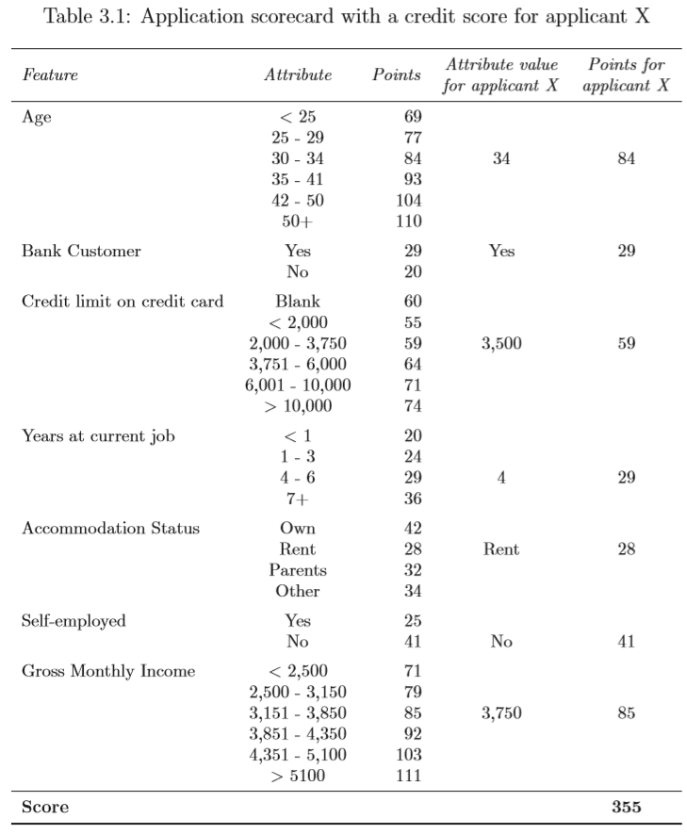
Credit Scoring
Source: Credit Scoring Using Machine Learning. Kenneth Kennedy. https://arrow.dit.ie/sciendoc/137/

Slide 62
Scorecard Model Development
Data Quality
Accuracy – degree of precision of measurements of a feature to its true value
Completeness – the extent to which values are missing in the data
Consistency – multiple data sources are used and due to a lack of standardisation, two or more data items may conﬂict with each other
Data discretisation / classing
Feature selection
Train / Test dataset
Model development and validation
Source: Building a Scorecard in Practice, https://bit.ly/2iKyw4n
Notes:
https://en.wikipedia.org/wiki/Credit_scorecards

Slide 63
Common Models
Logistic regression
Most commonly used algorithm within the consumer credit scoring industry
Supervised ML
Linear Discriminant Analysis (LDA)
Support Vector Machine
Neural Network
Decision Tree
Random forests

Slide 64
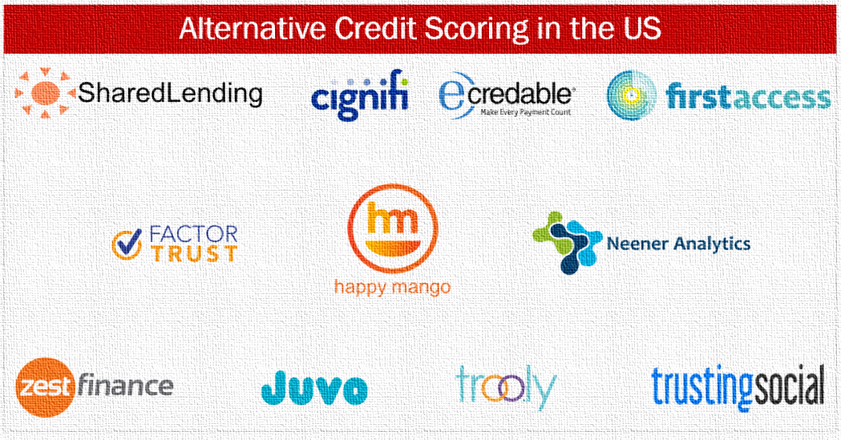
Notes:
https://gomedici.com/alternative-credit-scoring-us-data-science-financial-potential-thin-file/
https://www.eflglobal.com/alternative-data-credit-scoring-10-years-lessons/
https://en.wikipedia.org/wiki/Alternative_data
https://perspectives.tieto.com/blog/2017/09/social-and-alternative-data-driven-scoring--a-needed-complement-to-traditional-credit-scoring/

Slide 65

Alternative

Slide 66
Alternative Data
Utilities (gas, water, electricity)
Telecom (TV, mobile, broadband)
Rent
Property/asset record: including value of owned assets
Public records: beyond the limited public records information already found in standard credit reports
Alternative lending payments (e.g., payday, instalment loan, rent-to-own, buy-here-pay-here auto loans, auto title loans): including both on-time and derogatory payment data
Demand deposit account (DDA) information: including recurring payroll deposits and payments, average balance, etc.
Source: Alternative Data and the Unbanked https://owy.mn/2Gxwwn7

Slide 67
Alternative Data
Transaction Data
Telecom / Rent / Utility Data
Social Profile Data
Social Network Data
Clickstream Data
Audio and Text Data
Survey Data
Mobile App Data
Source: http://www.fico.com/en/blogs/analytics-optimization/using-alternative-data-in-credit-risk-modeling/
Notes:
http://www.fico.com/en/blogs/analytics-optimization/using-alternative-data-in-credit-risk-modeling/
http://www.fico.com/en/blogs/analytics-optimization/how-to-build-credit-risk-models-using-ai-and-machine-learning/

Slide 68
Transaction Data
How customers use their credit or debit cards.
Not often mined to extract the maximum predictive value.
Can be used to generate a wide range of predictive characteristics
Ratios of Cash to Total Spend in last X week(s)
Ratios of Spend in last X week(s) to last Y week(s)
Characteristics based on
Number
Frequency
Value of transactions at different retailer types
Source: http://www.fico.com/en/blogs/analytics-optimization/using-alternative-data-in-credit-risk-modeling/

Slide 69
Social Profile Data
Facebook, LinkedIn, Twitter, Instagram, Snapchat or other social media sites
Concerns:
Regulatory hurdles
Privacy issues
Easy to manipulate
Source: http://www.fico.com/en/blogs/analytics-optimization/using-alternative-data-in-credit-risk-modeling/

Slide 70
Social Network Analysis
Map a consumer’s network
Identify all the files and accounts for a single customer
Identify the individual’s connections with other people
Especially useful when evaluating a new credit applicant with no or little credit history. The credit ratings of the applicant’s network can provide useful information.
Potential regulatory issue
Source: http://www.fico.com/en/blogs/analytics-optimization/using-alternative-data-in-credit-risk-modeling/

Slide 71
Other Data Sources
Clickstream Data.
How a customer moves through your website, where they click and how long they take on a page can be predictive.
Audio and Text Data.
Information found on credit applications
In recorded customer service or collections calls.
Complement “thin files” / lacked credit history
Source: http://www.fico.com/en/blogs/analytics-optimization/using-alternative-data-in-credit-risk-modeling/

Slide 72
“Alternative”
Data showing trends or patterns in traditional loan repayment data.
Payment data relating to non-loan products requiring regular (typically monthly) payments, such as telecommunications, rent, insurance, or utilities.
Checking account transaction and cashflow data and information about a consumer’s assets, which could include the regularity of a consumer’s cash inflows and outflows, or information about prior income or expense shocks.
Source: https://files.consumerfinance.gov/f/documents/20170214_cfpb_Alt-Data-RFI.pdf

Slide 73
“Alternative”
Data that some consider to be related to a consumer’s stability, which might include information about the frequency of changes in residences, employment, phone numbers or e-mail addresses.
Data about a consumer’s educational or occupational attainment, including information about schools attended, degrees obtained, and job positions held.
Behavioural data about consumers, such as how consumers interact with a web interface or answer specific questions, or data about how they shop, browse, use devices, or move about their daily lives.
Data about consumers’ friends and associates, including data about connections on social media.
Source: https://files.consumerfinance.gov/f/documents/20170214_cfpb_Alt-Data-RFI.pdf

Slide 74
Characteristics of Good Alternative Data
Coverage: a new data source will ideally have broad and consistent coverage
Specificity: a data source should ideally contain detailed data elements about an individual – data elements that provide part of a full picture of the borrower (e.g., ontime and late payments over a significant time series, or specific asset or income data)
Accuracy and timeliness: data should be accurate and frequently updated
Predictive power (‘signal’): most important, data should contain information relevant to the behaviour that you’re trying to predict
Orthogonality: ideally, the data source should be additive to traditional bureau data; this means that using it will improve the predictive accuracy of any new score by improving the signal-to-noise ratio
Regulatory compliance: data sources must comply with existing regulations for consumer credit (i.e., Fair Credit Reporting Act, Equal Credit Opportunity Act, Gramm-Leach-Bliley Act)
Source: Alternative Data and the Unbanked https://owy.mn/2Gxwwn7

Slide 75
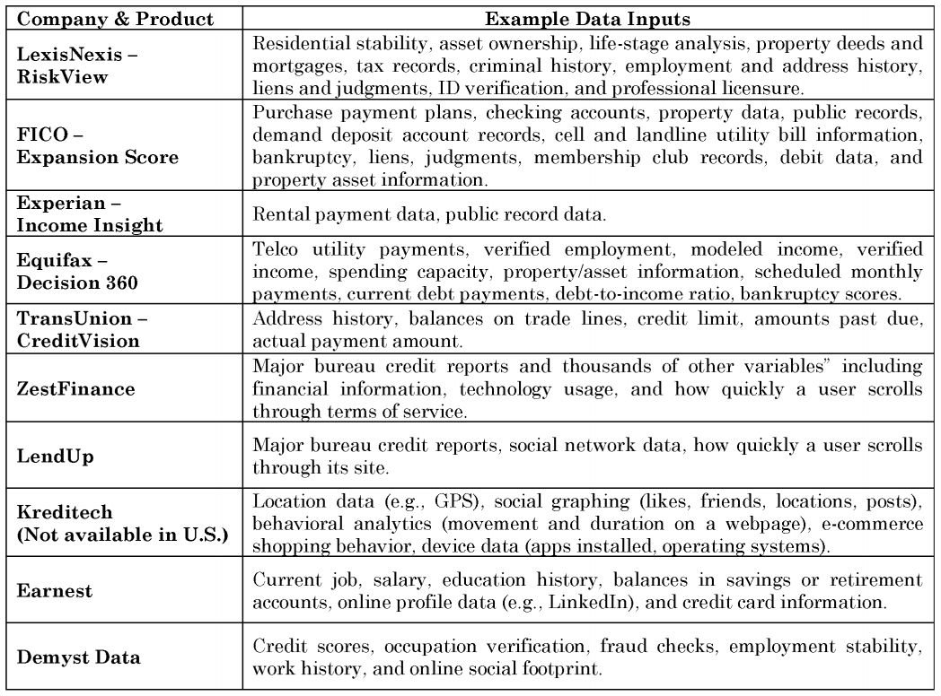
Source: Credit Scoring in The Era of Big Data, https://bit.ly/2vdxhi9

Slide 76
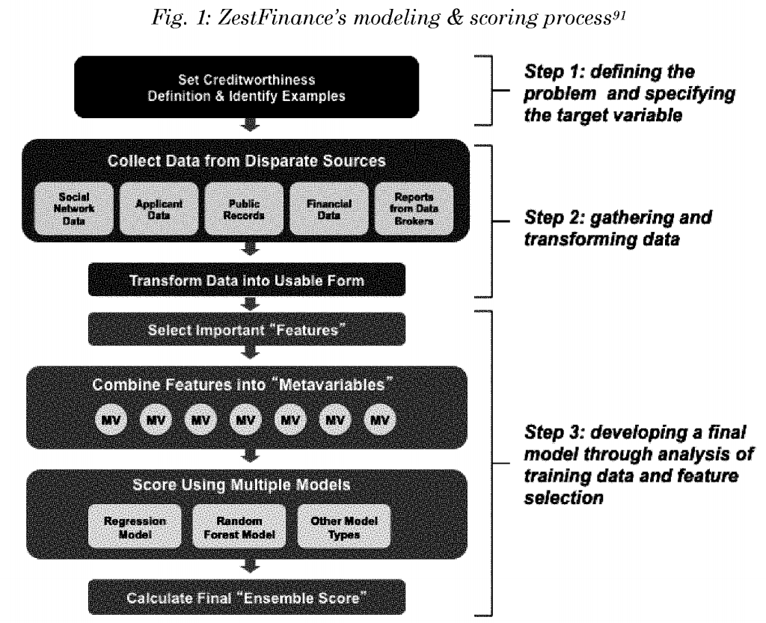
Source: Credit Scoring in The Era of Big Data, https://bit.ly/2vdxhi9

Slide 77
Microfinance to the Unbanked
Adams: Walk me through the process of applying for a loan.
Siroya: You download the app and answer eight questions that revolve around demographic and location data. On the back end we’re already scoring you. We send a loan offer. If you accept you get the capital directly into your mobile wallet. Eighty-five percent of customers are getting cash in their wallet in two minutes. We laugh about the fact that we can’t ask for a loan and get money in two minutes. We’re open 24 hours a day. A customer can request capital and get it in under two minutes at four in the morning.
Source: https://bit.ly/2GzYwqh

Slide 78
Microfinance to the Unbanked
Adams: How do you track a person’s daily movements?
Siroya: Through GPS data that comes through the operating system of the phone
Adams: What are you looking for?
Siroya: Consistency and the verification of identity. For example, if someone says they work at an office job and we never end up seeing them in that location, that’s kind of strange.

Slide 79
Microfinance to the Unbanked
Adams: What was your default rate at first?
Siroya: When you first start, you do blind lending. You want to have defaults. If you don’t, you can’t build a credit model. We had a default rate of 50% to 60%. Once we built the model, it went down to less than 10%.

Slide 80
Credit Scoring and Bankruptcy Prediction
Support Vector Machine (SVM)

Slide 81
Support Vector Machine (SVM)
A set of supervised learning methods used for classification, regression and outliers detection.
The advantages of support vector machines are:
Effective in high dimensional spaces.
Still effective in cases where number of dimensions is greater than the number of samples.
Uses a subset of training points in the decision function (called support vectors), so it is also memory efficient.
Versatile: different Kernel functions can be specified for the decision function. Common kernels are provided, but it is also possible to specify custom kernels.
Source: http://scikit-learn.org/stable/modules/svm.html

Slide 82
Support Vector Machine (SVM)
The disadvantages of support vector machines include:
If the number of features is much greater than the number of samples, avoid over-fitting in choosing Kernel functions and regularization term is crucial.
SVMs do not directly provide probability estimates, these are calculated using an expensive five-fold cross-validation.

Slide 83
Support Vector Machine (SVM)
Notes:
http://www.svms.org/finance/
http://www.svms.org/finance/Huang-etal2004.pdf
http://www.svms.org/finance/ShinLeeKim2005.pdf

Slide 84
Churn Prediction
Linear / Quadratic Discriminant Analysis

Slide 85
What is Churn?
Also called customer attrition / turnover / defection
The loss of clients or customers
Notes:
https://docs.microsoft.com/en-us/azure/machine-learning/studio/azure-ml-customer-churn-scenario
https://www.kdnuggets.com/2017/03/datascience-building-predictive-churn-model.html
https://aws.amazon.com/blogs/machine-learning/predicting-customer-churn-with-amazon-machine-learning/
https://towardsdatascience.com/churn-prediction-with-machine-learning-e6612cd5538f
https://tensorflow.rstudio.com/blog/keras-customer-churn.html
https://www.kaggle.com/mainakdatageek/churn-prediction-machine-learning-starter
https://www.h2o.ai/wp-content/uploads/2017/03/Case-Studies_PayPal.pdf
https://en.wikipedia.org/wiki/Customer_attrition
https://www.researchgate.net/profile/Konstantinos_Chatzisavvas/publication/273439405_A_Comparison_of_Machine_Learning_Techniques_for_Customer_Churn_Prediction/links/574edb0008aec50945bb3e95/A-Comparison-of-Machine-Learning-Techniques-for-Customer-Churn-Prediction.pdf
https://www.indecs.eu/2016/indecs2016-pp116-124.pdf
https://content.pivotal.io/blog/churn-prediction-in-retail-finance-and-asset-management-part-1
https://www.mckinsey.com/industries/telecommunications/our-insights/reducing-churn-in-telecom-through-advanced-analytics
http://www.hbs.edu/faculty/Publication%20Files/14-020_3553a2f4-8c7b-44e6-9711-f75dd56f624e.pdf
Prediction Solutions
https://jfin-swufe.springeropen.com/articles/10.1186/s40854-016-0029-6
https://pdfs.semanticscholar.org/0890/20f8ee2a269f523d5fec62819f6e264aac6e.pdf
https://tensorflow.rstudio.com/blog/keras-customer-churn.html
https://www.kaggle.com/mainakdatageek/churn-prediction-machine-learning-starter

Slide 86
Benefits of Customer Retention
Successful customer retention lowers the need for seeking new and potentially risky customers, and allows organisations to focus more accurately on the needs of their existing customers by building relationships
Long-term customers buy more and, if satisfied, may provide new referrals through positive word-of-mouth for the company
Long-term customers become less costly to serve due to the bank’s greater knowledge of the existing customer and to decreased servicing costs
They tend to be less sensitive to competitive marketing activities
Losing customers not only leads to opportunity costs because of reduced sales, but also to an increased need for attracting new customers, which is five to six times more expensive than customer retention
Source: Dirk Van den Poel, et. al. Customer Attrition Analysis For Financial Services Using Proportional Hazard Models.
Notes:
Successful customer retention lowers the need for seeking new and potentially risky customers, and allows organisations to focus more accurately on the needs of their existing customers by building relationships (Dawes and Swailes, 1999; Engel et al, 1995);
Long-term customers buy more (Paulin et al, 1998; Ganesh et al, 2000) and, if satisfied, may provide new referrals through positive word-of-mouth for the company (Ganesh et al, 2000; Colgate et al, 1996);
Long-term customers become less costly to serve due to the bank’s greater knowledge of the existing customer and to decreased servicing costs (Ganesh et al, 2000; Paulin et al, 1998);
They tend to be less sensitive to competitive marketing activities (Colgate et al, 1996);
Losing customers not only leads to opportunity costs because of reduced sales, but also to an increased need for attracting new customers (Athanassopoulus, 2000), which is five to six times more expensive than customer retention (Bhattacharya, 1998; Colgate and Danaher, 2000; Rasmusson, 1999).

Slide 87
Predictive Models
Multilayer Perceptron
Logistic Regression
Decision Trees
Random Forest
Support Vector Machine
Ensemble Models

Slide 88
Linear / Quadratic Discriminant Analysis
Attractive because they have closed-form solutions
Inherently multiclass
Proven to work well in practice
No hyperparameters tuning necessary
LDA determines the discriminant dimension in response pattern space, on which the ratio of between-class over within-class variance of the data is maximized (Duda et al., 2000; Bishop, 2007).
Notes:
https://stats.stackexchange.com/questions/172969/conceptual-undersanding-of-linear-discriminant-analysis
https://web.stanford.edu/~hastie/Papers/ESLII.pdf
http://scikit-learn.org/stable/modules/lda_qda.html
https://en.wikipedia.org/wiki/Linear_discriminant_analysis
http://sebastianraschka.com/Articles/2014_python_lda.html
https://www.ncbi.nlm.nih.gov/pmc/articles/PMC2914143/
https://labicvl.github.io/docs/pubs/TK_PhD_Thesis.pdf

Slide 89
Fraud Detection
AdaBoost

Slide 90
Loan Repayment Prediction
Linear & Logistic Regression
Notes:
https://businessperspectives.org/media/zoo/applications/publishing/templates/article/assets/js/pdfjs/web/5653

Slide 91
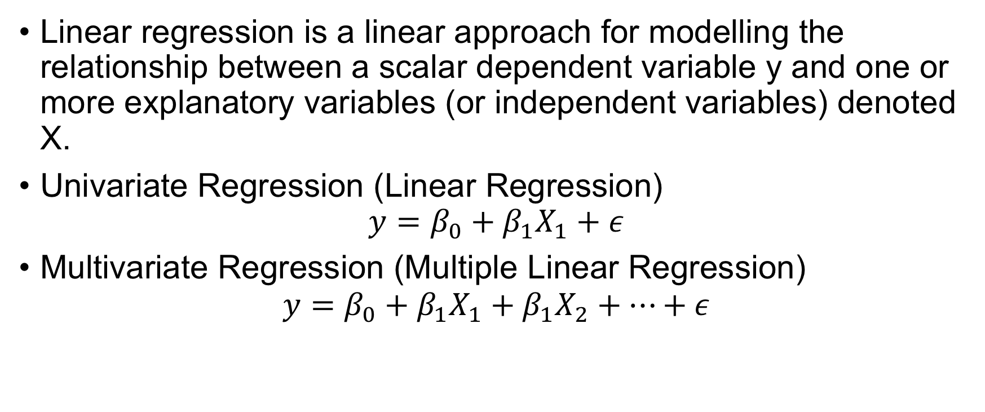
What is Regression
Linear regression is a linear approach for modelling the relationship between a scalar dependent variable y and one or more explanatory variables (or independent variables) denoted X.
Univariate Regression (Linear Regression)
$$y=β_{0}+β_{1}X_{1}+ε$$
Multivariate Regression (Multiple Linear Regression)
$$y=β_{0}+β_{1}X_{1}+β_{1}X_{2}+…+ε$$
Notes:
https://en.wikipedia.org/wiki/Linear_regression

Slide 92
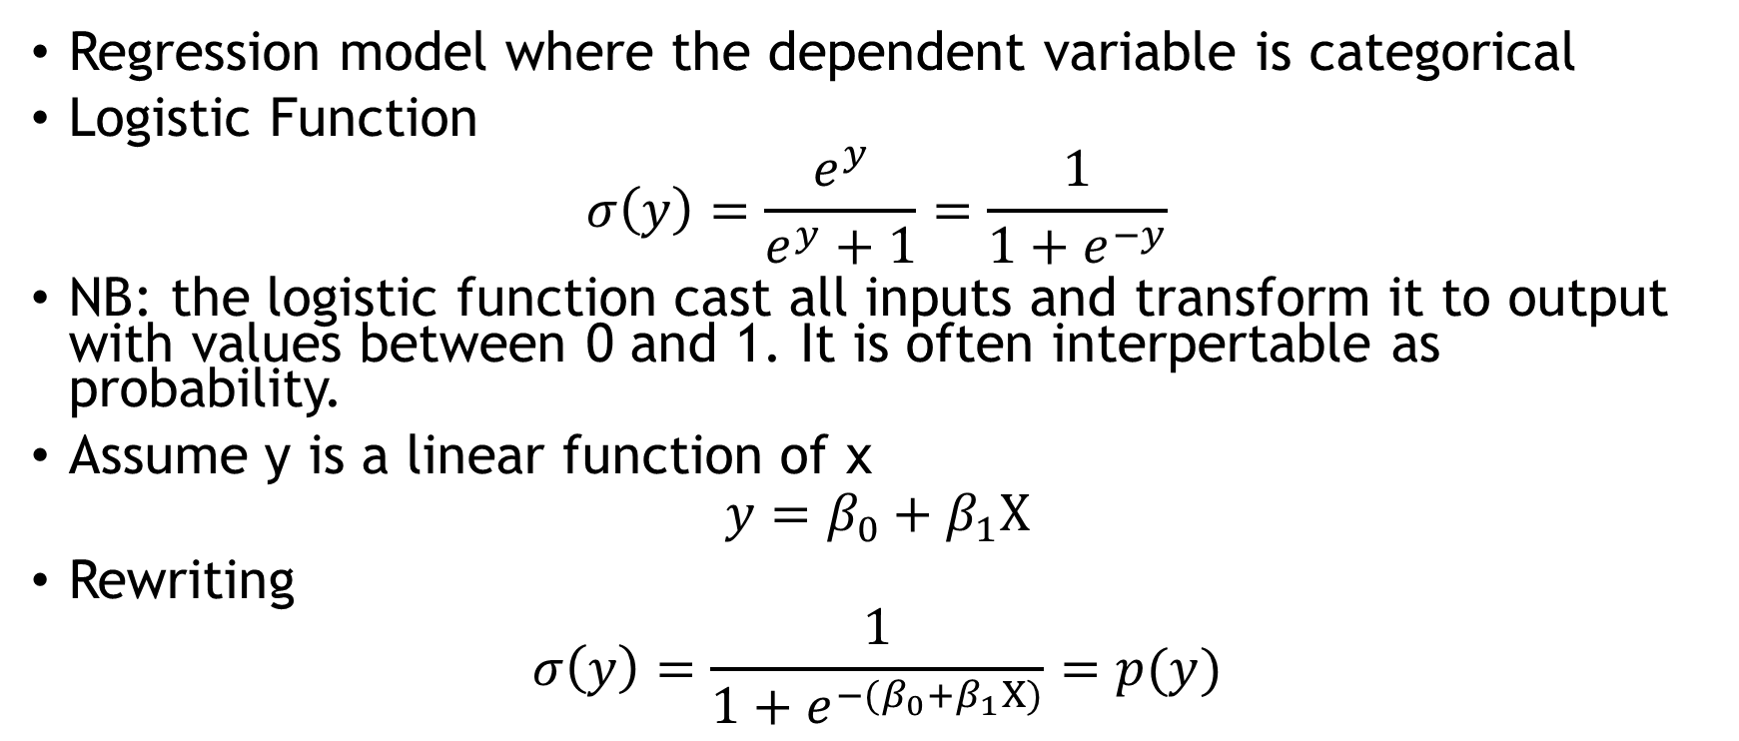
What is Logistic Regression
Regression model where the dependent variable is categorical
Logistic Function
$$σ\left(y\right)=\frac{e^{y}}{e^{y}+1}=\frac{1}{1+e^{−y}}$$
NB: the logistic function cast all inputs and transform it to output with values between 0 and 1. It is often interpertable as probability.
Assume y is a linear function of x
$$y=β_{0}+β_{1}X$$
Rewriting
$$σ\left(y\right)=\frac{1}{1+e^{−(β_{0}+β_{1}X)}}=p(y)$$
Notes:
https://en.wikipedia.org/wiki/Logistic_regression

Slide 93
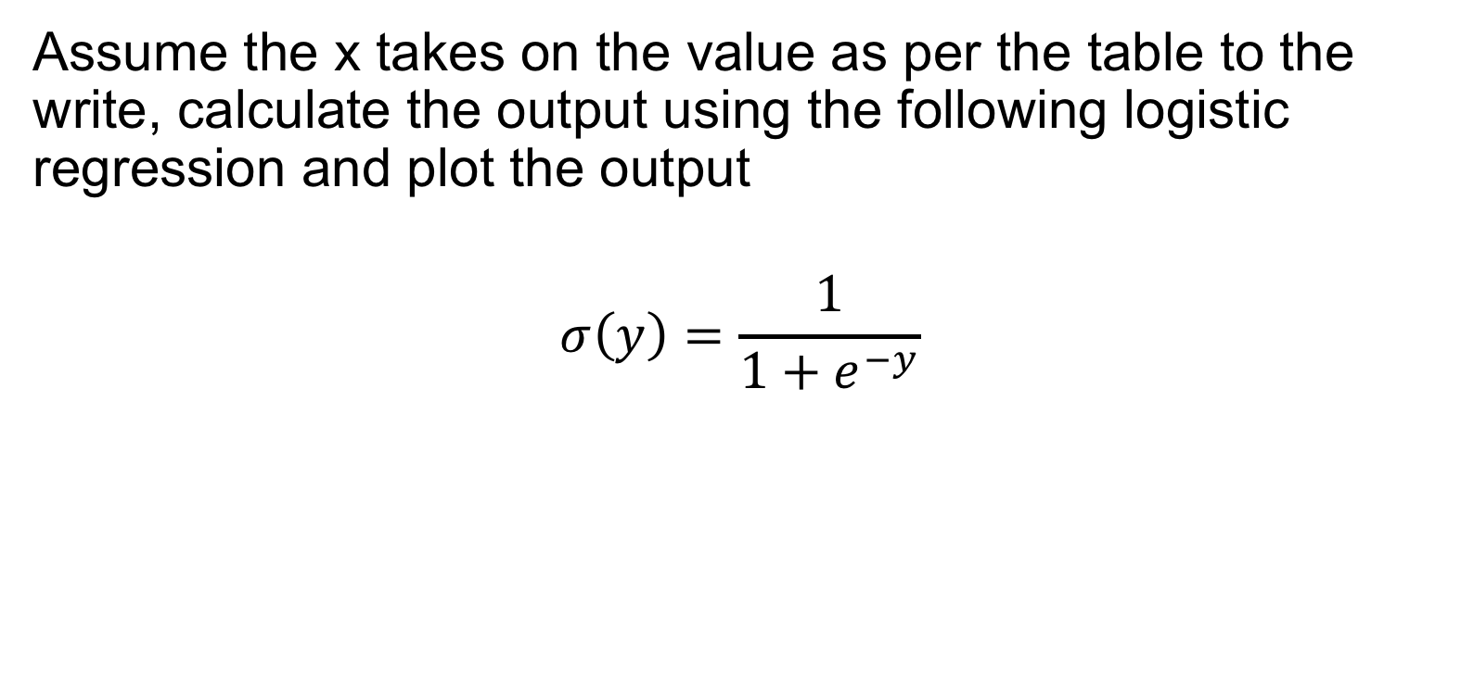
Assume the x takes on the value as per the table to the write, calculate the output using the following logistic regression and plot the output
$$σ\left(y\right)=\frac{1}{1+e^{−y}}$$
X | Y
-6
-5
-4
-3
-2
-1
0
1
2
3
4
5

Slide 95
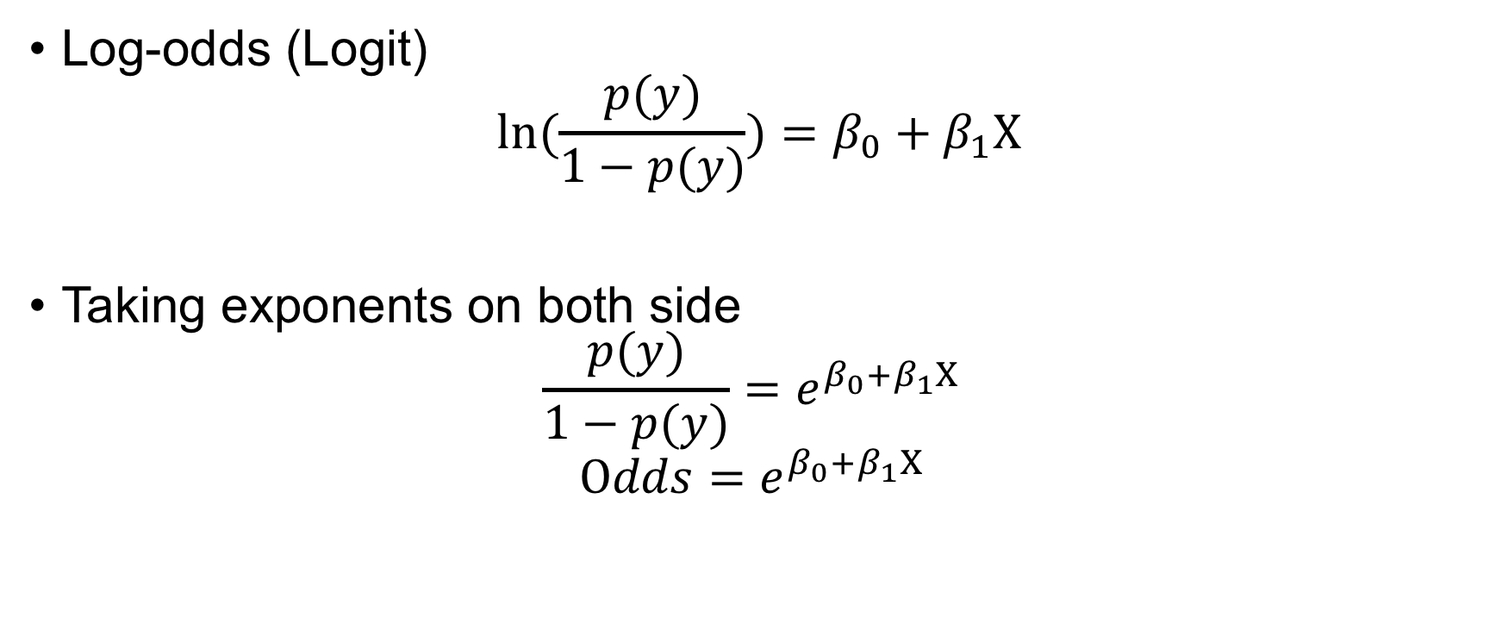
What is Logistic Regression
Log-odds (Logit)
$$ln(\frac{p(y)}{1−p(y)})=β_{0}+β_{1}X$$
Taking exponents on both side
$$\frac{p(y)}{1−p(y)}=e^{β_{0}+β_{1}X }$$
$$Odds=e^{β_{0}+β_{1}X }$$

Slide 96
Machine Learning in Finance
Supervised Machine Learning

Slide 97
Customer Segmentation
K-Means Clustering

Slide 98
Machine Learning in Finance
Algorithmic Trading and Portfolio Allocation

Slide 99
Algorithmic Trading

Slide 100
What is Algorithmic Trading?
Covered the method of execution large orders by breaking them to small trade size and filling them without significantly moving the market.
Systematic trading with set rules in the form of algorithm(s) and little or no human intervention with a profit objective.

Slide 101
Pairs Trading as a Motivational Example
Market neutral trading strategy
Uncorrelated with the market return. In CAPM terminology, beta is zero or near zero
Profit in all market conditions
Constructed with only two assets
Concurrently long and short

Slide 102
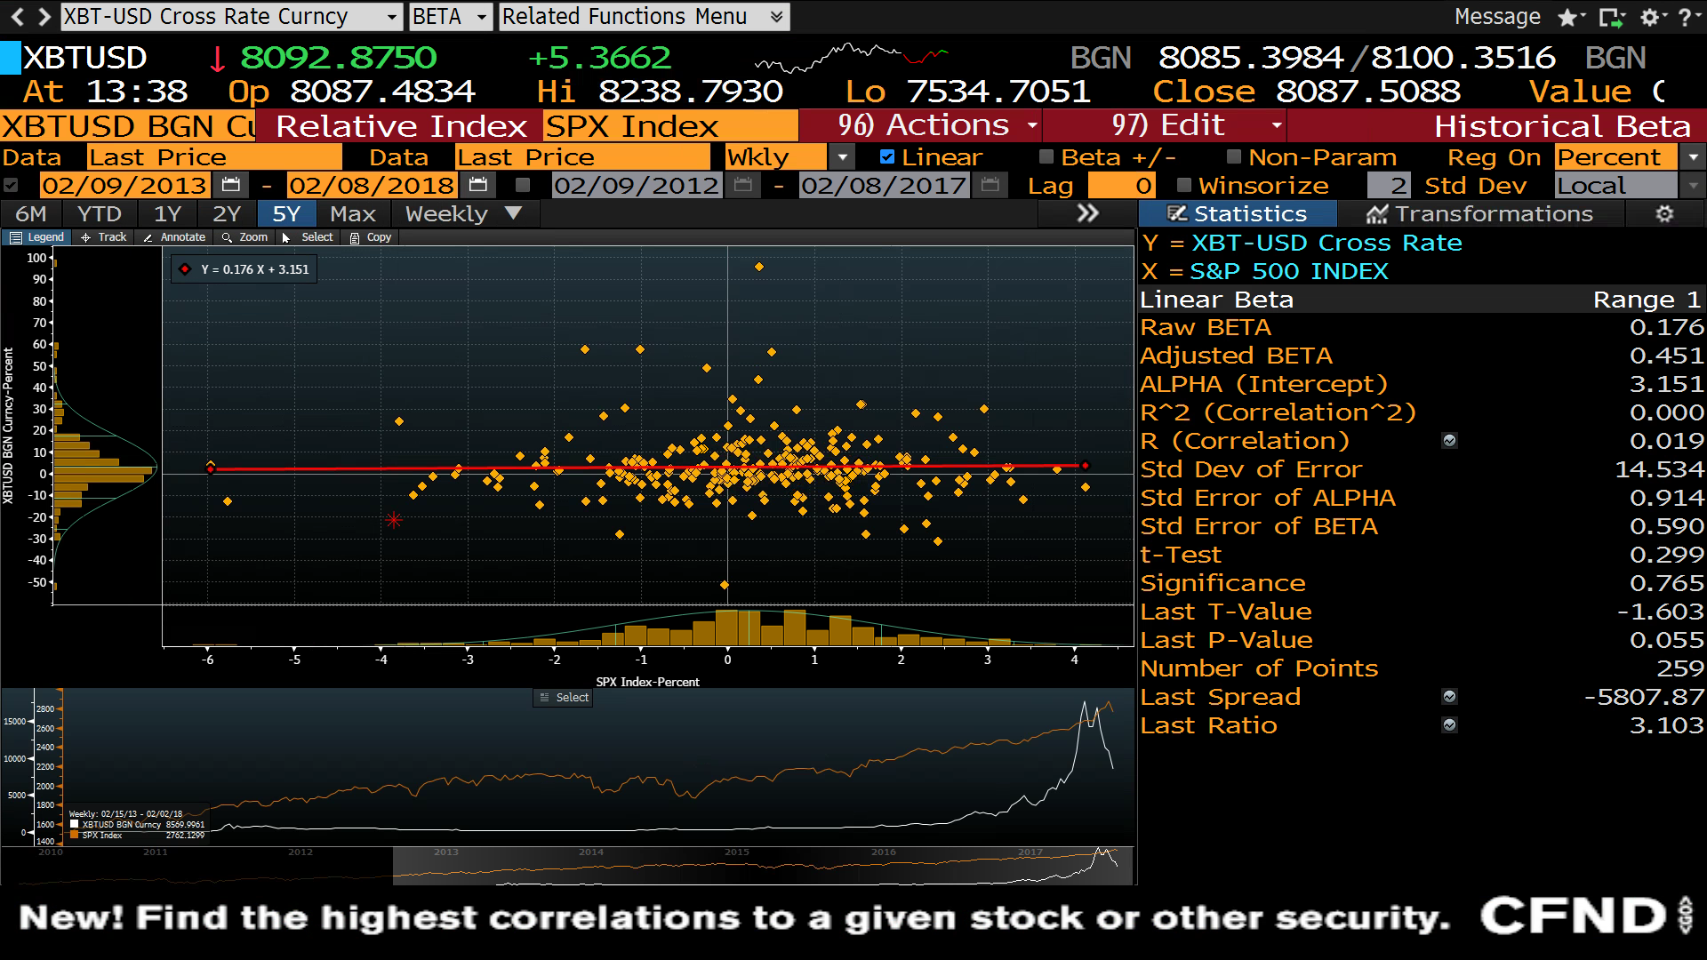

Slide 103
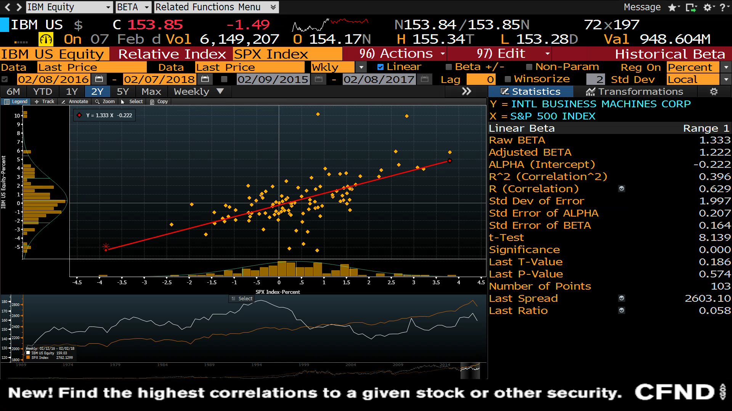

Slide 104
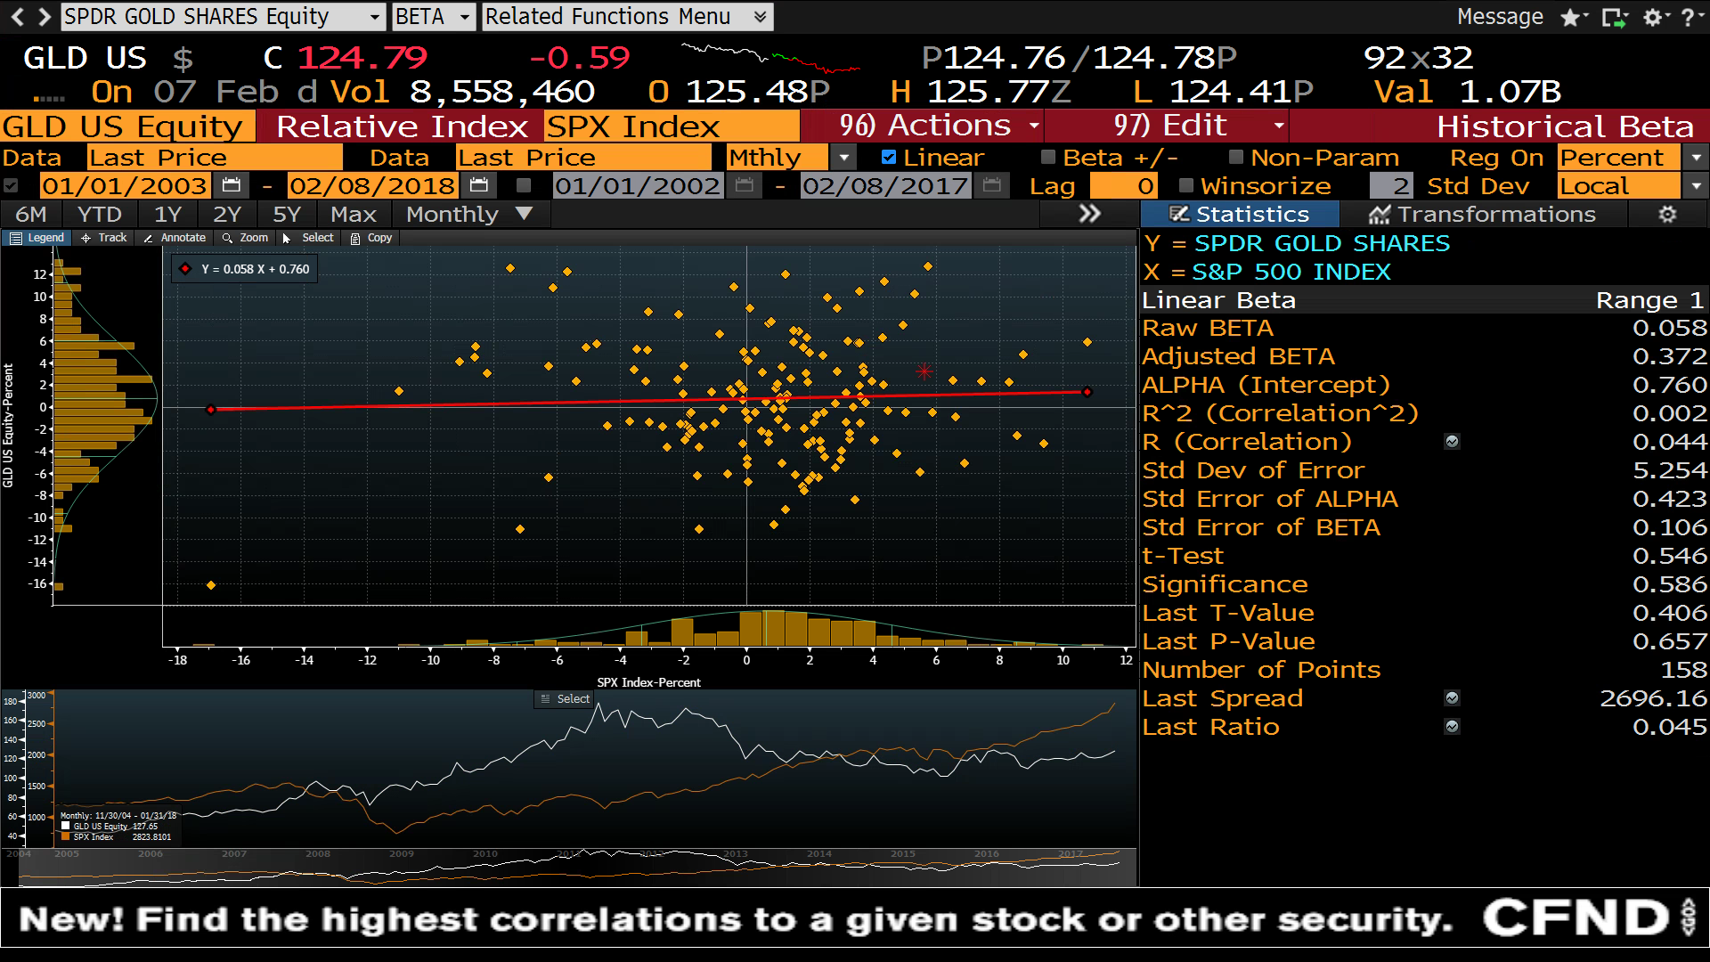

Slide 105
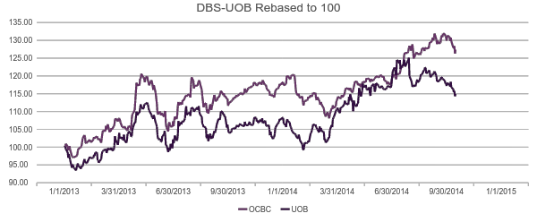
Simple Pairs Trading Example

Slide 106
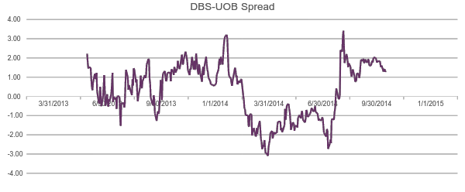
Simple Pairs Trading Example

Slide 107
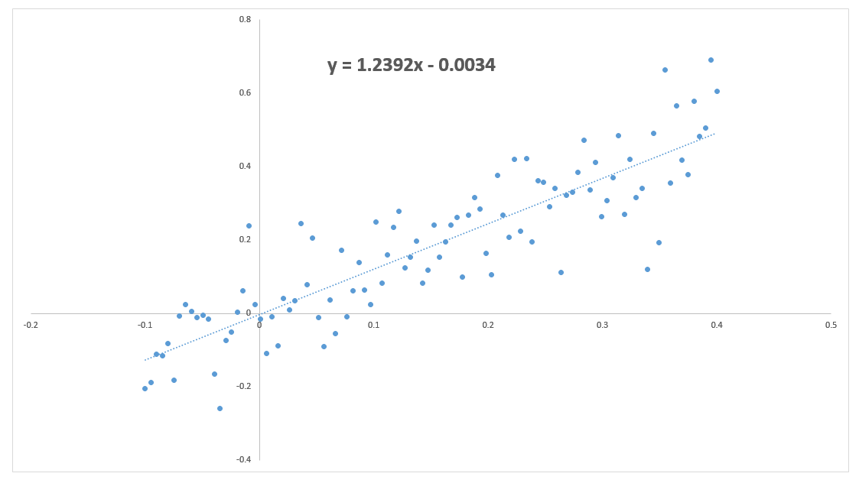
Performance Metrics
Total Returns
Benchmark Returns
Volatility
Sharpe Ratio
(Risk Premium) / SD

Slide 108
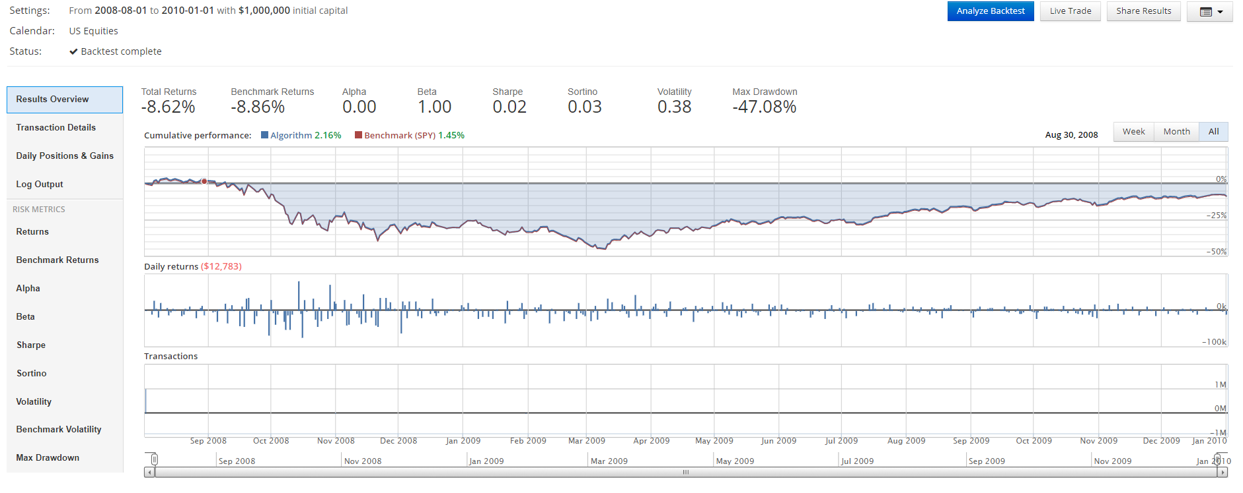
Benchmark – Long Only SPY

Slide 109
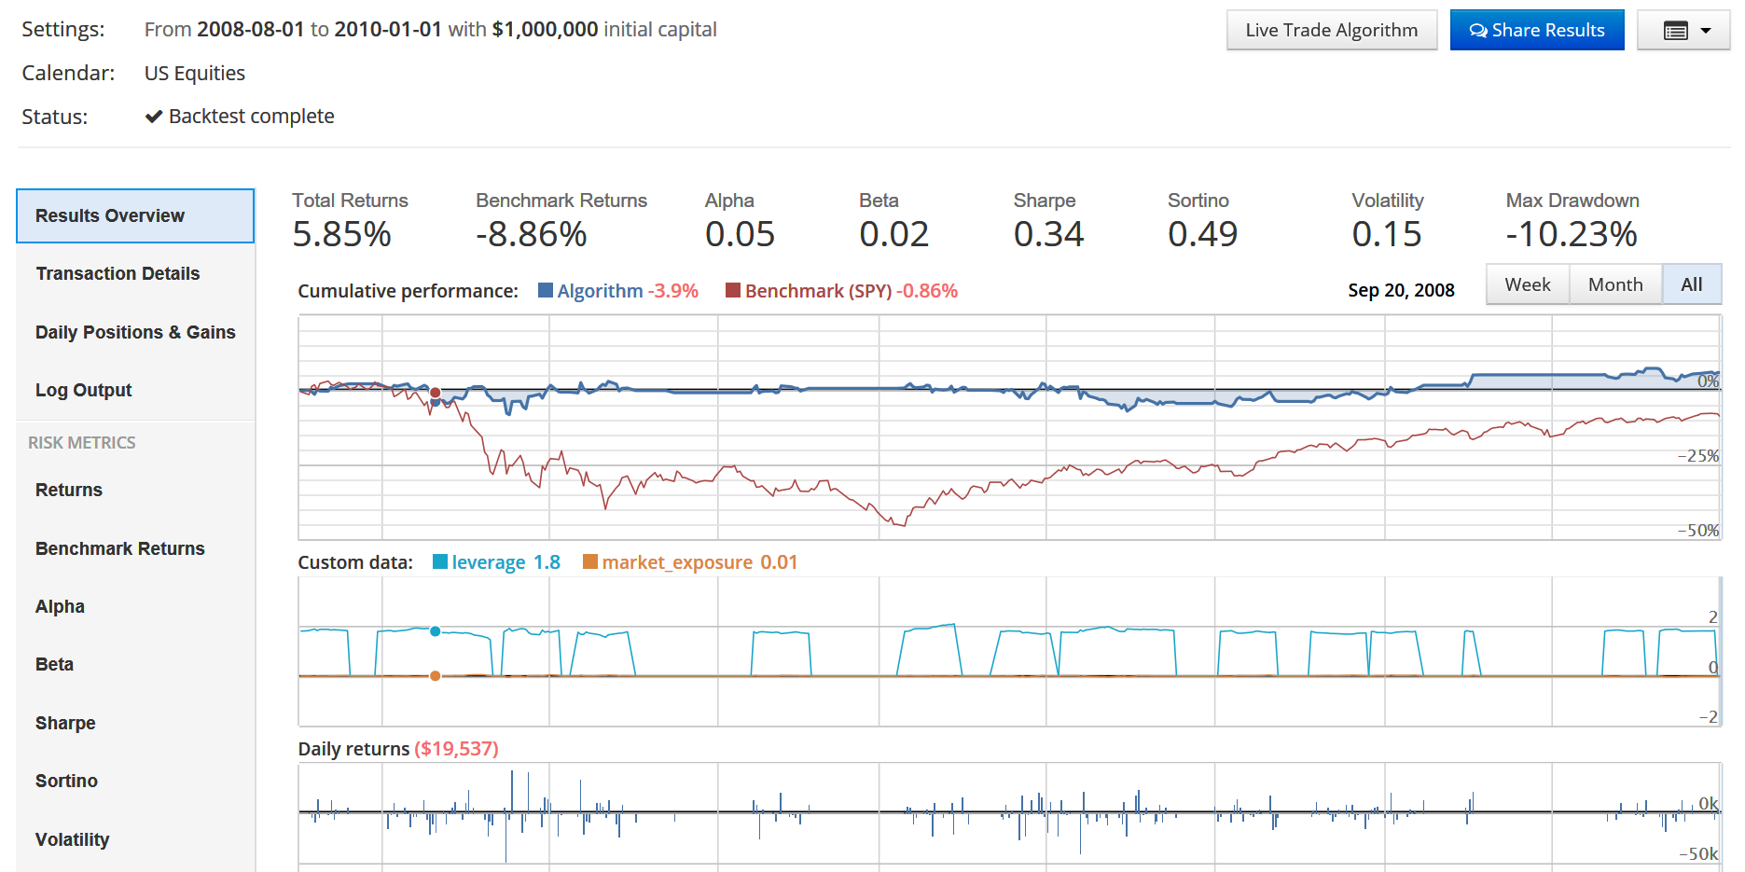
Pairs Trading Backtest Example
 | SPY | Pairs
Total Returns | -8.62% | 5.85%
Sharpe | 0.02 | 0.34
Volatility | 38% | 15%
Max Drawdown | -47% | -10%

Slide 110
Pairs Trading Technology
Distance Method
Cointegration Method
Linear Regression
Penalised Regression – Ridge, Lasso, ElasticNet
Kalman Filters
Cointegrated Augmented Dickey Fuller
Companies similarity
Clustering
Sentiment based
Market Regime Detection
Hidden Markov Models
RNN / LSTM
Reinforcement Learning

Slide 111
Quant Workflow
Data
Universe Definition
Alpha Discovery
Alpha Combination
Portfolio Construction
Trading

Slide 112
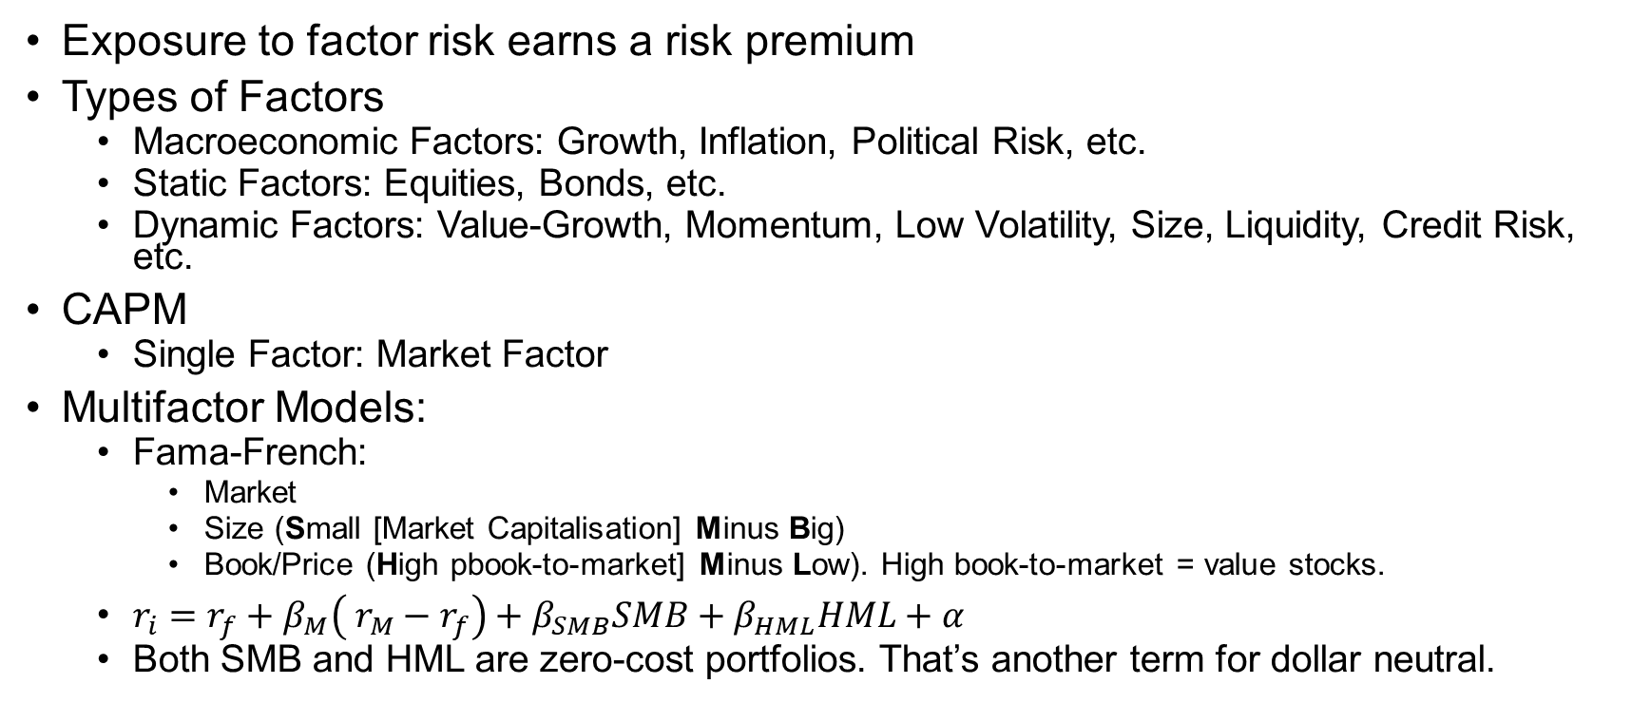
Factor Based Investing
Exposure to factor risk earns a risk premium
Types of Factors
Macroeconomic Factors: Growth, Inflation, Political Risk, etc.
Static Factors: Equities, Bonds, etc.
Dynamic Factors: Value-Growth, Momentum, Low Volatility, Size, Liquidity, Credit Risk, etc.
CAPM
Single Factor: Market Factor
Multifactor Models:
Fama-French:
Market
Size (Small [Market Capitalisation] Minus Big)
Book/Price (High pbook-to-market] Minus Low). High book-to-market = value stocks.
$r_{i}=r_{f}+β_{M}\left( r_{M}−r_{f}\right)+β_{SMB}SMB+β_{HML}HML+α$
Both SMB and HML are zero-cost portfolios. That’s another term for dollar neutral.
Notes:
https://en.wikipedia.org/wiki/Fama%E2%80%93French_three-factor_model

Slide 113
Benchmark – Long Only SPY

Slide 114
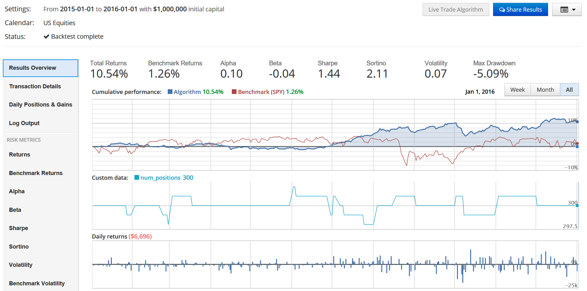
Long-Short Backtest Example
 | SPY | L/S
Total Returns | 0.33% | 10.54%
Sharpe | 0.10 | 1.44
Volatility | 16% | 7%
Max Drawdown | -11.8% | -5%

Slide 115
Factor Based Technology
Factor identifications
Deep learning
Alternative datasets
Slides (https://slides.com/anthonytyng/alternative_data/live)
Video (https://youtu.be/6GUKFoZKf5I)
Consumer transaction. E.g., POS data
Social Media / Sentiment
Online search
IoT
Satellite & Weather
etc.

Slide 116
Misc

Slide 117
Data Science Project Life-Cycle
Notes:
What is
Data Science Project Life-cycle?
Data Products?
Data Engineering?
https://www.datasciencecentral.com/profiles/blogs/the-data-science-project-lifecycle
https://www.dezyre.com/article/life-cycle-of-a-data-science-project/270
https://docs.microsoft.com/en-us/azure/machine-learning/team-data-science-process/overview
https://www.dataquest.io/blog/what-is-a-data-engineer/
https://cognitiveclass.ai/blog/data-scientist-vs-data-engineer/
http://www.juiceanalytics.com/writing/turning-data-into-product
https://www.safaribooksonline.com/library/view/think-like-a/9781633430273/kindle_split_026.html
https://vitalflux.com/data-science-project-life-cycle/
Data Project Lifecycle
1.1 Understand the different stages of data project life cycle 1.2 Explore data from different sources 1.3 Discuss the impact of implementing data in an organisation 1.4 Understand the types of data products
Data Management
Data Engineering

Slide 118

Team Data Science Process
Source: https://docs.microsoft.com/en-us/azure/machine-learning/team-data-science-process/overview

Slide 119

Cross-industry standard process for data mining (CRISP-DM)
Source: By Kenneth Jensen - Own work based on:
ftp://public.dhe.ibm.com/software/analytics/spss/documentation/modeler/18.0/en/ModelerCRISPDM.pdf
(Figure 1), CC BY-SA 3.0, https://commons.wikimedia.org/w/index.php?curid=24930610

Slide 120
Cross Industry Standard Process for Data Mining (CRISP-DM)
Business understanding
Data understanding
Data preparation
Modelling
Evaluation
Deployment

Slide 121
knowledge discovery in databases (KDD) process
Selection
Pre-processing
Transformation
Data mining
Interpretation/evaluation.

Slide 122
Lifecycle of Data Science Project
Data Acquisition
Data Preparation
Hypothesis and Modelling
Evaluation and Interpretation
Deployment
Operations
Optimization
Notes:
Life Cycle of a Data Science Project
https://www.dezyre.com/article/life-cycle-of-a-data-science-project/270
https://www.datasciencecentral.com/profiles/blogs/the-data-science-project-lifecycle

Slide 123
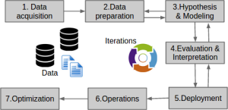

Slide 124
Data Acquisition
Key person
Various data sets
APIs
Web scraping
Logs from webservers
Social media data
Online repositories like US Census datasets
Internal and external sources
Data quality, control, integrity, governance
Goal: Sourcing data that can value add to solve business problems
Notes:
A major challenge that data professionals often encounter in data acquisition step is tracking where each data slice comes from and whether the data slice acquired is up-to-date or not. It is important to track this information during the entire lifecycle of a data science project as data might have to be re-acquired to test other hypothesis or run any other updated experiments.

Slide 125
Data Preparation
“Exploratory data analysis” is an attitude, a state of flexibility, a willingness to look for those things that we believe are not there, as well as those we believe to be there. — John Tukey
Also called data cleaning or data wrangling
Identification of various data quality issues – missing data, inconsistent, semantic errors
Data often not in a usable format
Manually clean and reformat the data
Identify potential problems that may affect down stream analysis
Assumptions
Exploratory data analysis is an integral part of this process
Identification of outliers, anomalies and patterns
What can we use this data for?
Goal: Data that can be easily analysed

Slide 126
Hypothesis and Modelling
Apply machine learning techniques to obtain meaningful business insights from data.
Multiple machine learning models are used
Model selection
Train, validate and test
Goal: Derive meaningful business insights

Slide 127
Evaluation and Interpretation
Evaluation
Continuous
RMSE (root mean squared error)
Classification
Average accuracy, AUC and log loss
Train, validate, test

Slide 128
Deployment
Pilot
Test
Production
Continuous Delivery

Slide 129
Operations/Maintenance
Continuous monitoring
Product Maintenance
Performance monitoring
Keep an eye out for performance degradation

Slide 130
Optimisation
Continuous retraining of the machine learning model
Batch and online learning:
Batch learning. The model / system cannot learn incrementally. It must be training using all available data. Frequently called offline learning. All the data are used to train the model. The model is then put into production and no learning takes place while it is in production.
Online learning. Train the model incrementally by feeding mini-batches and works well for system with continuous streams of data

Slide 131
Analytics Job Roles
Notes:
https://www.springboard.com/blog/data-science-career-paths-different-roles-industry/
https://hophr.com/blog
https://www.roberthalf.com/sites/default/files/documents/2018_salary_guide_NA_technology_1.pdf
What is
Data Science Project Life-cycle?
Data Products?
Data Engineering?
https://www.datasciencecentral.com/profiles/blogs/the-data-science-project-lifecycle
https://www.dezyre.com/article/life-cycle-of-a-data-science-project/270
https://docs.microsoft.com/en-us/azure/machine-learning/team-data-science-process/overview
https://www.dataquest.io/blog/what-is-a-data-engineer/
https://cognitiveclass.ai/blog/data-scientist-vs-data-engineer/
http://www.juiceanalytics.com/writing/turning-data-into-product
https://www.safaribooksonline.com/library/view/think-like-a/9781633430273/kindle_split_026.html
https://vitalflux.com/data-science-project-life-cycle/
Data Project Lifecycle
1.1 Understand the different stages of data project life cycle 1.2 Explore data from different sources 1.3 Discuss the impact of implementing data in an organisation 1.4 Understand the types of data products
Data Management
Data Engineering

Slide 132
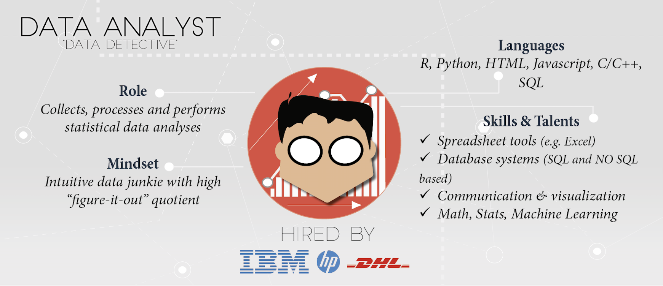
Source: Datacamp

Slide 133
Data Analyst
Query and process data, provide reports, summarize and visualize data.
Strong understanding of how to leverage existing tools and methods to solve a problem, and help people from across the company understand specific queries with ad-hoc reports and charts.
Not expected to deal with analysing big data,
Not expected to have the mathematical or research background to develop new algorithms for specific problems.
Skills: Data Analysts need to have a baseline understanding of some core skills: statistics, data munging, data visualization, exploratory data analysis,
Tools: Microsoft Excel, SPSS, SPSS Modeler, SAS, SAS Miner, SQL, Microsoft Access, Tableau, SSAS.
Source: Cognitive

Slide 134
Business Intelligence Developers
Data experts that interact more closely with internal stakeholders to understand the reporting needs, and then to collect requirements, design, and build BI and reporting solutions for the company.
Have to design, develop and support new and existing data warehouses, ETL packages, cubes, dashboards and analytical reports.
Work with databases, both relational and multidimensional, and should have great SQL development skills to integrate data from different resources.
Meet the enterprise-wide self-service needs.
Not expected to perform data analyses.
Skills: ETL, developing reports, OLAP, cubes, web intelligence, business objects design,
Tools: Tableau, dashboard tools, SQL, SSAS, SSIS and SPSS Modeler.
Source: Cognitive

Slide 135
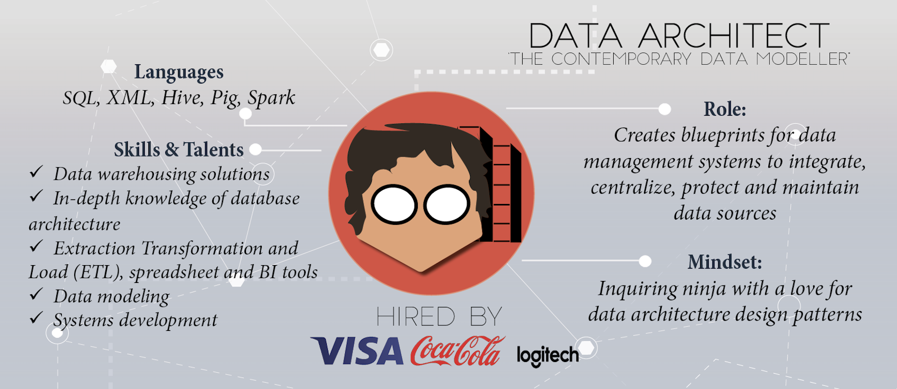
Source: Datacamp

Slide 136
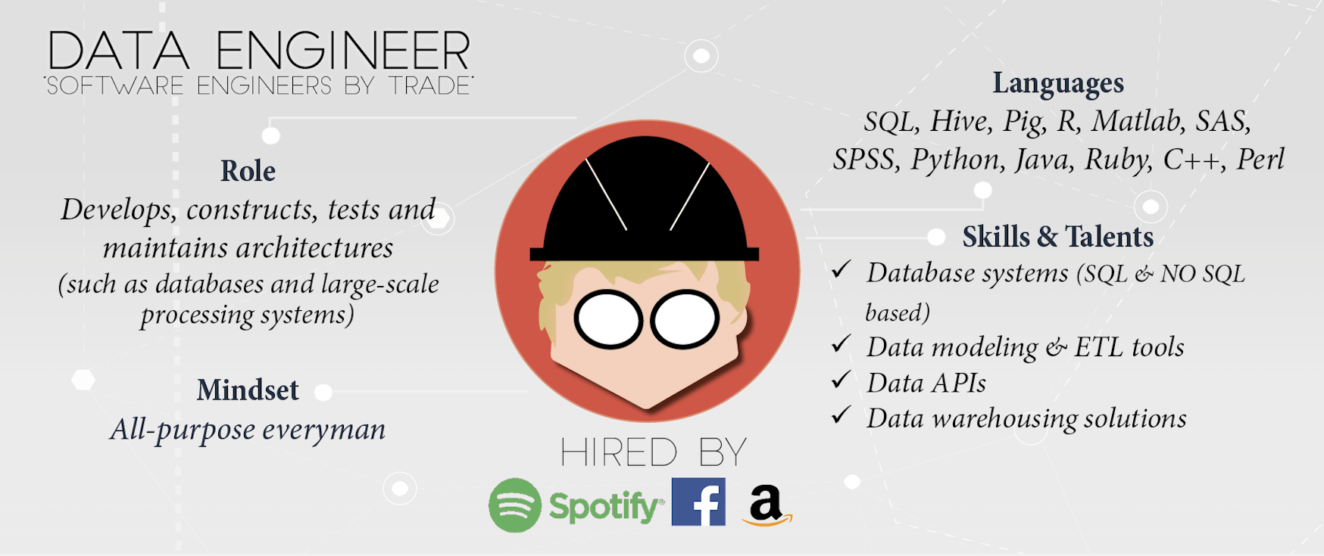
Source: Datacamp

Slide 137
Data Engineer
Prepare the “big data” infrastructure to be analysed by Data Scientists.
Software engineers who design, build, integrate data from various resources, and manage big data.
Write complex queries on that, make sure it is easily accessible, works smoothly, and their goal is optimizing the performance of their company’s big data ecosystem.
Might also run some ETL (Extract, Transform and Load) on top of big datasets and create big data warehouses that can be used for reporting or analysis by data scientists.
Focus more on the design and architecture
Not expected to know any machine learning or analytics for big data.
Skills: Hadoop, MapReduce, Hive, Pig, Data streaming, NoSQL, SQL, programming.
Tools: DashDB, MySQL, MongoDB, Cassandra
Source: Cognitive

Slide 138
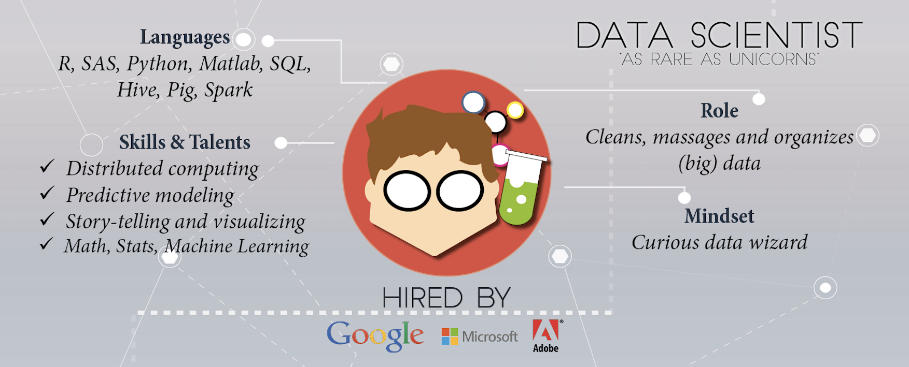
Source: Datacamp

Slide 139
Data Scientist
Turn raw data into purified insights.
Apply statistics, machine learning and analytic approaches to solve critical business problems.
Help organisations turn data into valuable and actionable insights.
Can be considered as an advanced level of data analysis that is driven and automated by machine learning and computer science.
In comparison with ‘data analysts’, in addition to data analytical skills, Data Scientists are expected to have strong programming skills, an ability to design new algorithms, handle big data, with some expertise in the domain knowledge.
Source: Cognitive

Slide 140
Data Scientist
Expected to interpret and deliver the results of their findings, by visualization techniques, building data science apps, or narrating interesting stories about the solutions to their data (business) problems.
Requires problem-solving skills and an understanding of traditional and new data analysis methods to build statistical models or discover patterns in data. May be presented with big data without a particular business problem in mind.
Expected to explore the data, come up with the right questions, and provide interesting findings.
To analyse the data, Data Scientists should have a very broad knowledge of different techniques in machine learning, data mining, statistics and big data infrastructures.
Source: Cognitive
Notes:
For example, creating a recommendation engine, predicting the stock market, diagnosing patients based on their similarity, or finding the patterns of fraudulent transactions.

Slide 141
Data Scientist
Experience working with different datasets of different sizes and shapes, and be able to run his algorithms on large size data effectively and efficiently.
Essential to know computer science fundamentals and programming, including experience with languages and database (big/small) technologies.
Skills: Python, R, Scala, Apache Spark, Hadoop, machine learning, deep learning, and statistics.
Tools: Data Science Experience, Jupyter, and RStudio.
Source: Cognitive

Slide 142
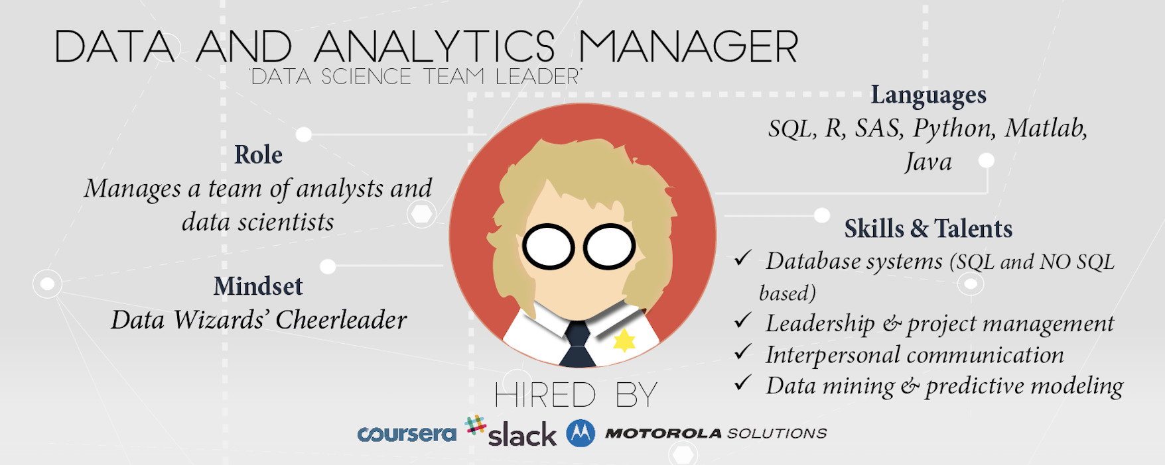
Source: Datacamp

Slide 143
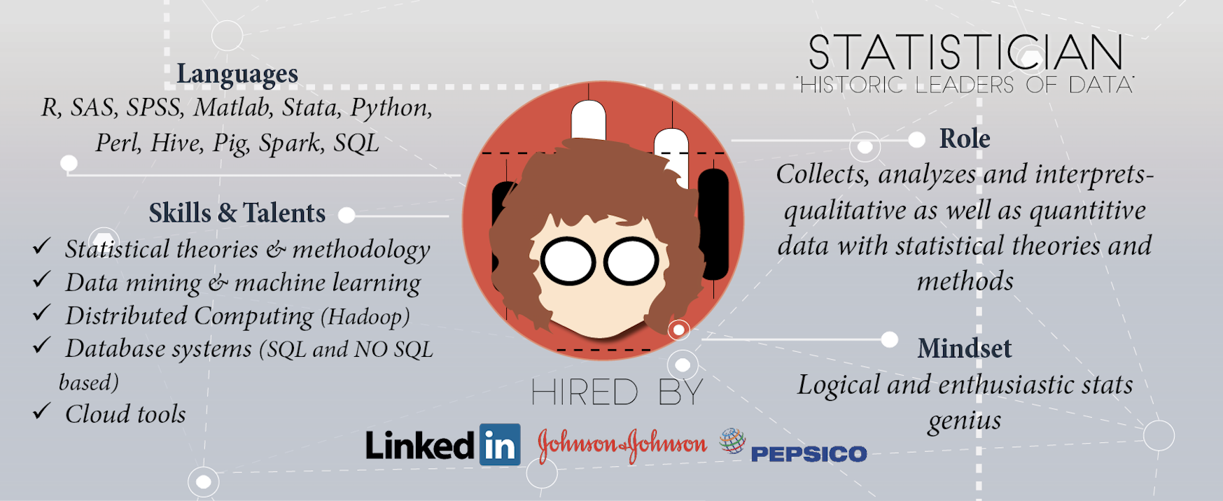
Source: Datacamp

Slide 144
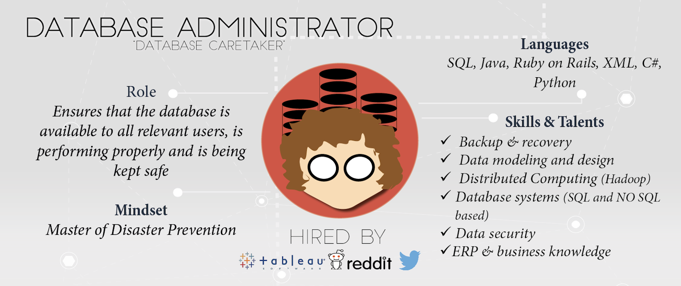
Source: Datacamp

Slide 145
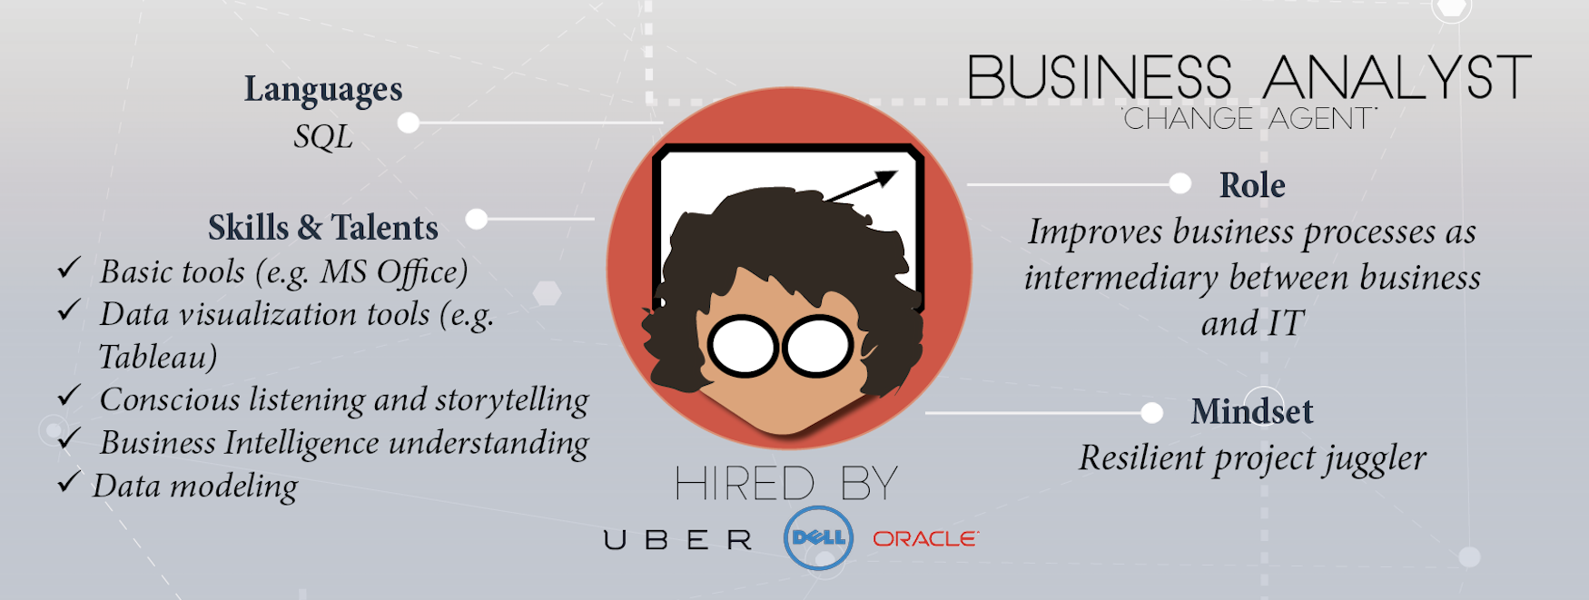
Source: Datacamp

